Slide 1
Data Science Essentials
Instructor: Patrick Boily

Slide 2

Data Science Essentials
P. Boily | UNIVERSITY OF OTTAWA | FACULTY OF SCIENCE | DEPARTMENT OF MATHEMATICS AND STATISTICS DATA ACTION LAB | IDLEWYLD ANALYTICS
With contributions from J. Schellinck | SYSABEE | DATA ACTION LAB

Slide 3

Instructor – Patrick Boily
Employment
Professor Math/Stat [‘19 – now, uOttawa]
President [‘16 – now, Idlewyld Analytics]
Manager and Senior Consultant [’12 – ‘19, CQADS, Carleton]
Public Service [’08 – ’12, ASFC | StatCan | TC | TPSGC]
60+ uni course; 250+ workshop days
Projects
GAC; NWMO; CATSA; etc.
40+ projects
Specialization
Data visualization; data cleaning (… unfortunately)
Application of wide breadth of techniques to all kinds of data
Mathematical/statistical modeling
DATA SCIENCE ESSENTIALS

Slide 4
Course Material
Course Webpage:
https://data-action-lab.com/101-dse
Contact Info:
pboily@uottawa.ca
Course Notes:
https://idlewyldanalytics.com
Slack Workspace:
https://dspdi.slack.com
DATA SCIENCE ESSENTIALS

Slide 5
Course Description
This course gives participants the opportunity to master foundational knowledge and skills needed for data analysis, along with a discussion of common challenges and pitfalls.
Participants will be introduced to various methods of data preparation, and to some intrinsic limitations of data and data analysis, and to easily avoidable pre-analysis mistakes.
Following the course, the participants have the option of working on a guided project, getting feedback from the instructor.
DATA SCIENCE ESSENTIALS

Slide 6
Additional Information
Exposure to programming frameworks would be beneficial but not necessary. Participants must be comfortable (not necessarily experts) with the concepts introduced in a Probability and Statistics university-level course.
Participants are required to bring a laptop/personal computer on which the current version of R/RStudio (Posit) are installed (for which they may require administrative authorisation to install packages).
Participants doing the guided project must be familiar with R and/or Python.
DATA SCIENCE ESSENTIALS

Slide 7
Learning Outcomes
At the end of this course, participants will be able to:
select appropriate methods to prepare their data for analysis
anticipate challenges and limitations inherent to data and desired analysis outcomes
apply data cleaning strategies to their data
conduct simple analyses
build simple data science pipelines to provide actionable insights
DATA SCIENCE ESSENTIALS

Slide 8
Course Outline
Technical and Non-Technical Aspects of Data Work
Quantitative Skills
Software and Tools
Multiple I’s Approach
Roles and Responsibilities
Analysis Cheat Sheet
Data Science Basics
Preliminaries
Conceptual Frameworks
Data Science Ethics
Analytics Workflows
Getting Insight From Data
Session 1
Session 2
Session 3
Session 4
DATA SCIENCE ESSENTIALS

Slide 9
Course Outline
Data Preparation
Data Quality and Data Wrangling
Missing Values
Anomalous Observations
Dimensionality & Data Transformations
Miscellanea
Data Engineering
Data Management
Session 1
Session 2
Session 3
Session 4
DATA SCIENCE ESSENTIALS

Slide 10
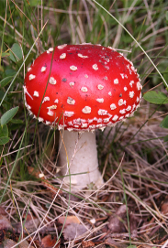
Poisonous Mushroom Problem
[https://archive.ics.uci.edu/ml/datasets/Mushroom]
Amanita muscaria
Habitat: woods Gill Size: narrow Odor: none Spores: white Cap Colour: red
Classification problem: Is Amanita muscaria edible, or poisonous?
DATA SCIENCE ESSENTIALS

Slide 11
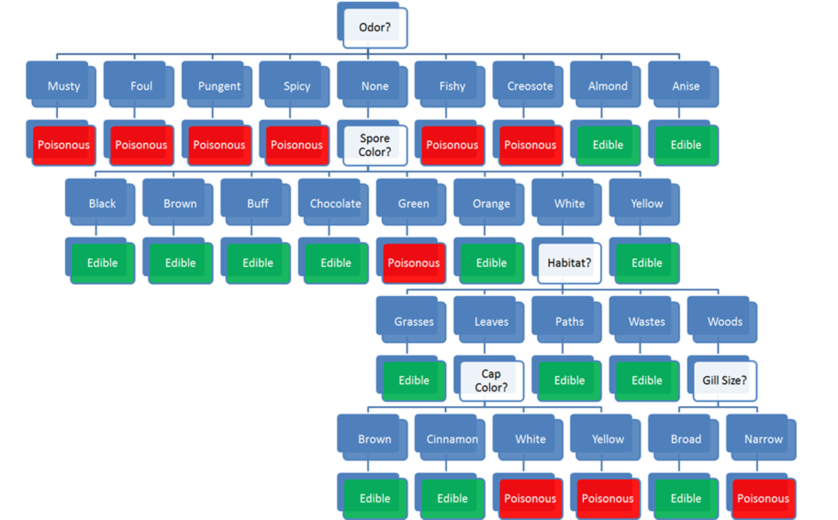
Habitat: woods
Gill Size: narrow
Odor: none
Spores: white
Cap Colour: red
Classification problem: edible or poisonous

Slide 12
Habitat: woods
Gill Size: narrow
Odor: none
Spores: white
Cap Colour: red
Classification problem: edible or poisonous

Slide 13
Habitat: woods
Gill Size: narrow
Odor: none
Spores: white
Cap Colour: red
Classification problem: edible or poisonous

Slide 14
Habitat: woods
Gill Size: narrow
Odor: none
Spores: white
Cap Colour: red
Classification problem: edible or poisonous

Slide 15
Habitat: woods
Gill Size: narrow
Odor: none
Spores: white
Cap Colour: red
Classification problem: edible or poisonous

Slide 16
Habitat: woods
Gill Size: narrow
Odor: none
Spores: white
Cap Colour: red
Classification problem: edible or poisonous

Slide 17
Discussion
Would you have trusted an “edible” prediction?
Where is the model coming from?
What would you need to know to trust the model?
What’s the cost of making a classification mistake, in this case?
DATA SCIENCE ESSENTIALS

Slide 18
Sister Courses
InTRODUCTION TO MACHINE LEARNING
Data visualization and Dashboards
POWER BI FOR BEGINNERS
Statistical Learning
Classification
Clustering
Issues and Challenges
Data Viz Concepts
Dashboarding
Storytelling with Data
Data Viz with ggplot2
The Tool
Exploration
Monitoring
Storytelling
DATA SCIENCE ESSENTIALS

Slide 19
Session 1
DATA SCIENCE ESSENTIALS

Slide 20
Technical and Non-Technical Aspects of Data Work
Session 1
DATA SCIENCE ESSENTIALS

Slide 21

1. Technical & Non-Technical Aspects of Data Work
Session 1
DATA SCIENCE ESSENTIALS

Slide 22
Quantitative Skills
Session 1
Out-of-academia context:
apply quantitative methods to (business) problems in order to obtain actionable insight
difficult for any given individual to have expertise in every field of mathematics, statistics, computer science, data science, data engineering, etc.
With a graduate degree in math/stats, for instance:
expertise in 2-3 areas
decent understanding of related disciplines
passing knowledge in various domains
Flexibility is an ally, perfectionism… only up to a point.
DATA SCIENCE ESSENTIALS

Slide 23
Quantitative Skills
Session 1
Suggestions:
keep up with trends
become conversant in your non-expertise areas
know where to find information
In many instances (70%?), only the basics (2nd–3rd year mandatory courses at uOttawa, say) are sufficient to meet government/industry needs.
Focus: make sure you really understand the basics, stepping stones.
In the rest of the cases, more sophisticated knowledge is required.
DATA SCIENCE ESSENTIALS

Slide 24
Quantitative Skills
Session 1
survey sampling and data collection
data processing and data cleaning
data visualization
mathematical modelling
statistical methods
regression analysis
queueing models
machine learning
deep learning
reinforcement learning
stochastic modelling (MC simulations)
optimization and operations research
survival analysis
Bayesian data analysis
anomaly detection and outlier analysis
feature selection/dimensions reduction
trend extraction and forecasting
cryptography and coding theory
design of experiment
graph and network theory
text mining/natural language processing
etc.
DATA SCIENCE ESSENTIALS

Slide 25
Software and Tools
Session 1
Modern quantitative work typically involves programming (or the use of point-and-click software, at the very least).
But programming languages go in and out of style.
It is important not just to understand the syntax of a particular language, but also how computer languages and computing infrastructure work in general.
ALSO: avoid getting caught up in programming wars … they’re more or less all functionally equivalent!
DATA SCIENCE ESSENTIALS

Slide 26
Software and Tools
Session 1
Programming (and Related)
Python, R, C/C++/C#, Perl, Julia, regexps (, Visual Basic?), Java, Ruby, etc.
Database Management
SQL and variants, ArangoDB, MongoDB, Redis, Amazon DynamoDB (, Access?), Big Query, Redshift, Synapse, etc.
Data Visualization
ggplot2, seaborn, plot.ly, Power BI, Tableau, D3.js, Google Data Studio, proprietary software, etc.
Simulations, Statistical Analysis, Data Analysis, Machine Learning
tidyverse, scikit-learn, numpy, pandas, scipy, MATLAB, Simulink, SAS, SPSS, STATA (, Excel?), Visio, TensorFlow, keras, Spark, Scala, etc.
Typesetting and Reporting
LaTeX, R Markdown, Adobe Illustrator, GIMP (, Word?, PowerPoint?), etc.
DATA SCIENCE ESSENTIALS

Slide 27
Software and Tools
Session 1
Q: At StatCan, R or SAS?
A: Not easy to answer as StatCan is in a slow transition period. The Agency is better equipped for SAS (with “Big Data” options, such as SAS Grid).
R is […] not as ideal for large files (e.g., Census data), so it is not an option in such cased because it is still too slow (unless you have very powerful servers). But we would prefer to use the R packages, so it’s a dilemma.
TL;DR: R is our future, but SAS is still very much our present. In times of transition, analysts/employees who know both are better positioned.
DATA SCIENCE ESSENTIALS

Slide 28
Multiple I’s Approach to Data Work
Session 1
Technical and quantitative proficiency (or expertise) is necessary to do good quantitative work in the real world, but it is not sufficient – optimal real-world solutions may not always be the optimal academic or analytical solutions.
This might be the biggest surprise for those transitioning out of academia.
What works for one person, one job application, one project, one client, etc. may not work for another – beware the tyranny of past success!
The focus of quantitative work must include the delivery of useful analyses/ products (Multiple “I”s).
DATA SCIENCE ESSENTIALS

Slide 29
Multiple I’s Approach to Data Work
Session 1
intuition understanding context
initiative establishing an analysis plan
innovation new ways to obtain results, if required
insurance trying multiple approaches
interpretability providing explainable results
insights providing actionable results
integrity staying true to objectives and results
independence self-learning and self-teaching
interactions strong analyses through teamwork
interest finding and reporting on interesting results
intangibles thinking “outside the box”;
inquisitiveness not only asking the same questions repeatedly
DATA SCIENCE ESSENTIALS

Slide 30
Multiple I’s Approach to Data Work
Session 1
Prospective employees/analysts are not solely gauged on technical know-how, but also on the ability to contribute positively to the workplace/project:
communication
team work and multi-disciplinary abilities
social niceties and flexibility
non-technical interests
Employers rarely chose robots when human beings are available; stakeholders are more likely to accept data recommendations from well-rounded people.
You should also evaluate eventual employers/clients on these axes.
DATA SCIENCE ESSENTIALS

Slide 31
Roles and Responsibilities
Session 1
A data analyst or a data scientist (in the singular) is unlikely to get meaningful results – there are simply too many moving parts to any data project.
Successful projects require teams of highly-skilled individuals who understand the data, the context, and the challenges.
Team size could vary from a few to several dozens; typically easier to manage small-ish teams (with 1-4 members, say, with role overlaps).
Domain Experts / SMEs
are authorities in a particular area or topic
guide team through unexpected complications and knowledge gaps
DATA SCIENCE ESSENTIALS

Slide 32
Roles and Responsibilities
Session 1
Project Managers / Team Leads
understand the process enough to recognize whether what is being done makes sense
provide realistic estimates of the time and effort required to complete tasks
act as intermediary between team and clients/stakeholders
responsible for project deliverables.
Data Translators
have a good grasp on the data and the data dictionary
help SMEs transmit the underlying context to the data science team
Data Engineers / Database Specialists
work with clients and stakeholders to acquire useable data sources
may participate in the analyses, but are not necessarily specialists
DATA SCIENCE ESSENTIALS

Slide 33
Roles and Responsibilities
Session 1
Data Analysts
clean and process data
prepare initial visualizations
have a decent understanding of quantitative methods (at most 1 area of expertise)
conduct preliminary analyses
Data Scientists
work with processed data to build sophisticated models
focus on actionable insights
have a sound understanding of algorithms/quantitative methods (2 or 3 areas of expertise)
can apply them to a variety of data scenarios
can be counted on to catch up on new material quickly
DATA SCIENCE ESSENTIALS

Slide 34
Roles and Responsibilities
Session 1
Computer Engineers
design and build computer systems and pipelines
are involved in software development and deployment of data science solutions
AI/ML Quality Assurance/Quality Control Specialists
design testing plans for solutions that implement AI/ML models
help the team determine whether the models are able to learn
Communication Specialists
communicate actionable insights to managers, policy analysts, decision-makers, stake holders
may participate in the analyses, but are not necessarily specialists (often data translators)
keep abreast of popular accounts of quantitative results and developments
DATA SCIENCE ESSENTIALS

Slide 35
Analysis Cheat Sheet
Session 1
Business solutions are not always academic solutions.
Data and models don’t always support the stakeholder’s hopes, wants, needs.
Timely communication is key – externally and internally.
Data scientists need to be flexible (within reason), and willing and able to learn something new, quickly.
Not every problem calls for data science methods.
We should learn from both our good and our bad experiences.
DATA SCIENCE ESSENTIALS

Slide 36
Analysis Cheat Sheet
Session 1
Manage projects and expectations.
Maintain a healthy work-life balance.
Respect the stakeholders, the project, the methods, and the team.
Data science is not about how smart we are; it is about how we can provide actionable insight.
When what the client wants can’t be done, offer alternatives.
“There ain’t no such thing as a free lunch.”
DATA SCIENCE ESSENTIALS

Slide 37
Suggested Reading
Session 1
Data Understanding, Data Analysis, Data Science Non-Technical Aspects of Data Work First Principles
The “Multiple I’s” Approach
Roles and Responsibilities
Consulting/Analysis Cheatsheet
Lessons Learned
Technical and Non-Technical Aspects of Data Work
DATA SCIENCE ESSENTIALS

Slide 38
Exercises
Session 1
Which of the quantitative skills presented in this section do you possess? Which interest you? Which do you plan on learning about?
Which of the software skills presented in this section do you possess? Which interest you? Which do you plan on learning about?
What data role do you hold in your organization? Which role do you think you are currently best suited for? Which role do you aspire to?
Have you encountered the Analysis Cheat Sheet lessons in your work? Have you encountered others?
Technical and Non-Technical Aspects of Data Work
DATA SCIENCE ESSENTIALS

Slide 39
Data Science Basics
Session 1
DATA SCIENCE ESSENTIALS

Slide 40

2. Preliminaries
Session 1
DATA SCIENCE ESSENTIALS

Slide 41
The Digital/Analog Data Dichotomy
Session 1
Humans have been collecting data for a long time; J.C. Scott argues that data collection was a major enabler of the modern nation-state.
For most of the history of data collection, we have lived in the analogue world (understanding grounded in continuous experience of physical reality).
Our data collection activities were the first steps towards a different strategy for understanding and interacting with the world.
Data leads us to conceptualize the world in a way that is more discrete than continuous.
DATA SCIENCE ESSENTIALS

Slide 42
The Digital/Analog Data Dichotomy
Session 1
Translating our experiences into numbers and categories, we create sharper and more definable boundaries than our raw experience might suggest.
This discretization strategy leads to the digital computer (series of 1s and 0s), which is surprisingly successful at representing our physical world: the digital world is taking on a reality as pervasive and important as the physical one.
This digital world is built on top of the physical world, but it does not operate under the same set of rules.
in the physical world, the default is to forget; in the digital world, it is to remember
in the physical world, the default is private; in the digital world, the default is public
in the physical world, copying is hard; in the digital world, copying is easy
DATA SCIENCE ESSENTIALS

Slide 43
The Digital/Analog Data Dichotomy
Session 1
Digitization is making things that were once hidden, visible; once veiled, transparent.
Data scientists are scientists of the digital world. They seek to understand:
the fundamental principles of data
how these fundamental principles manifest themselves in different digital phenomena
Ultimately, data and the digital world are tied to the physical world. What is done with data has repercussions in the physical world; and it is crucial for data scientists to have a solid grasp of the fundamentals and context of data work before leaping into the tools and techniques that drive it forward.
DATA SCIENCE ESSENTIALS

Slide 44
What is Data?
Session 1
It is difficult to give a clear-cut definition of data (is it singular or plural?).
Linguistically, a datum is “a piece of information”, so data means “pieces of information,” or collection of “pieces of information”.
Data represents the whole (potentially greater than the sum of its parts) or simply the idealized concept.
Is that clear?
DATA SCIENCE ESSENTIALS

Slide 45
What is Data?
Session 1
Is the following data?
4,529 red 25.782 Y
Why? Why not? What, if anything is missing?
The Stewart approach: “we know it when we see it.”
Pragmatically, we think of data as a collection of facts about objects and their attributes.
DATA SCIENCE ESSENTIALS

Slide 46

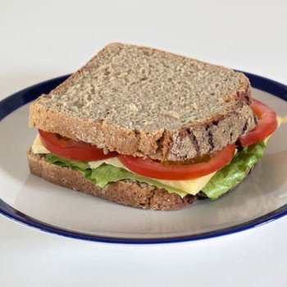
Objects and Attributes
Session 1
Object: apple
Shape: spherical
Colour: red
Function: food
Location: fridge
Owner: Jen
Object: sandwich
Shape: rectangle
Colour: brown
Function: food
Location: office
Owner: Pat
Remember: an object is not simply the sum of its attributes.
DATA SCIENCE ESSENTIALS

Slide 47
Objects and Attributes
Session 1
Ambiguities when it comes to measuring (and recording) the attributes:
apple picture is a 2-dimensional representation of a 3-dimensional object
overall shape of the sandwich is vaguely rectangular, it is not exact (measurement error?)
insignificant for most, but not necessarily all, analytical purposes
apple’s shape = volume, sandwich’s shape = area (incompatible measurements)
a number of potential attributes are not mentioned: size, weight, time, etc.
are there other issues?
Measurement errors and incomplete lists are always part of the picture; is this collection of attributes providing a reasonable description of the objects?
DATA SCIENCE ESSENTIALS

Slide 48

[R. Magritte, La trahison des images (ceci n’est pas une pipe)]

Slide 49
From Objects and Attributes to Datasets
Session 1
Raw data may exist in any format.
A dataset represents a collection of data that could conceivably be fed into algorithms for analytical purposes.
Datasets appear in a table format, with rows and columns; attributes are the fields (or columns, variables); objects are instances (or cases, rows, records).
Objects are described by their feature vector (observation’s signature) – the collection of attributes associated with value(s) of interest.
DATA SCIENCE ESSENTIALS

Slide 50
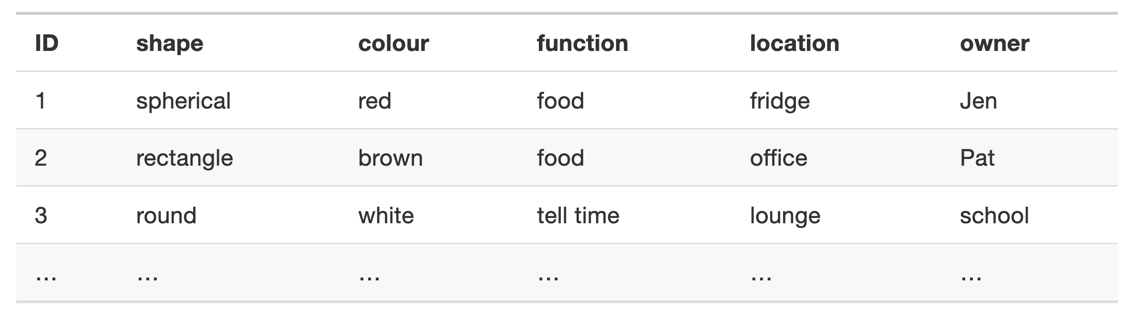
From Objects and Attributes to Datasets
Session 1
The dataset of physical objects could start with:
DATA SCIENCE ESSENTIALS

Slide 51
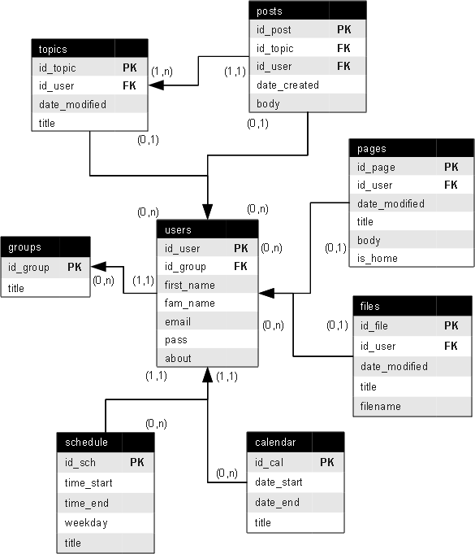
From Objects and Attributes to Data
Session 1
[Wooptoo, “Entity - relationship model.” Wikimedia]
In practice, more complex databases are used, for a variety of reasons that we briefly discuss at a later stage.
DATA SCIENCE ESSENTIALS

Slide 52
Data in the News
Session 1
Here is a sample of headlines and article titles showcasing the growing role of data science (DS), machine learning (ML), and artificial/augmented intelligence (AI) in different domains of society.
While these demonstrate some of the functionality/capabilities of DS/ML/AI technologies, it is important to remain aware that new technologies are always accompanied by emerging social consequences (not always positive).
DATA SCIENCE ESSENTIALS

Slide 53
Data in the News
Session 1
“Robots are better than doctors at diagnosing some cancers, major study finds”
“Deep-learning-assisted diagnosis for knee magnetic resonance imaging: Development and retrospective validation of MRNet”
“Google AI claims 99% accuracy in metastatic breast cancer detection”
“Data scientists find connections between birth month and health”
“Scientists using GPS tracking on endangered Dhole wild dogs”
“These AI-invented paint color names are so bad they’re good”
“We tried teaching an AI to write Christmas movie plots. Hilarity ensued. Eventually.”
“Math model determines who wrote Beatles’ "In My Life": Lennon or McCartney?”
DATA SCIENCE ESSENTIALS

Slide 54
Data in the News
Session 1
“Scientists use Instagram data to forecast top models at New York Fashion Week”
“How big data will solve your email problem”
“Artificial intelligence better than physicists at designing quantum science experiments”
“This researcher studied 400,000 knitters and discovered what turns a hobby into a business”
“Wait, have we really wiped out 60% of animals?”
“Amazon scraps secret AI recruiting tool that showed bias against women”
“Facebook documents seized by MPs investigating privacy breach”
“Firm led by Google veterans uses A.I. to ‘nudge’ workers toward happiness”
“At Netflix, who wins when it’s Hollywood vs.the algorithm?”
DATA SCIENCE ESSENTIALS

Slide 55
Data in the News
Session 1
“AlphaGo vanquishes world’s top Go player, marking A.I.’s superiority over human mind”
“An AI-written novella almost won a literary prize”
“Elon Musk: Artificial intelligence may spark World War III”
“A.I. hype has peaked so what’s next?”
Opinions on the topic are varied – to some, DS/ML/AI provide examples of brilliant successes, while to others it is the dangerous failures that are at the forefront.
What do you think?
Are you a glass half-full or glass half-empty sort of person when it comes to data and applications?
DATA SCIENCE ESSENTIALS

Slide 56
Session 1
From: Science isn’t broken - It’s just a hell of a lot harder than we give it credit for. [Christie Aschwanden, 2015]

Slide 57
Suggested Reading
Session 1
Data Understanding, Data Analysis, Data Science Data Science Basics Introduction
What is Data?
From Objects and Attributes to Datasets
Data in the News
The Analog/Digital Data Dichotomy
Preliminaries
DATA SCIENCE ESSENTIALS

Slide 58
Exercises
Session 1
Find examples of recent “Data in the News” stories. Were they successes or failures? What social consequences could emerge from the technologies described in the stories?
In what format is your organization’s data available? Are you able to access it easily? Is it updated regularly? Are there data dictionaries? Have you read them?
Preliminaries
DATA SCIENCE ESSENTIALS

Slide 59

3. Conceptual Frameworks
Session 1
DATA SCIENCE ESSENTIALS

Slide 60
Conceptual Frameworks
Session 1
We use data to represent the world. But we also:
describe the world using language
represent it by building physical models
Common thread: representation (an object standing for another, being used in its stead in order to indirectly engage with the object being represented).
On one hand: “the map is not the territory”, but we do not need much effort to use the map to navigate the territory.
The transition from representation to represented can be seamless, which is risky: it is easy to mistake the data/analytical results for the real world.
DATA SCIENCE ESSENTIALS

Slide 61
Conceptual Frameworks
Session 1
Best protection: thought out and explicitly described conceptual framework
a specification of which parts of the world are being represented
how they are represented
the nature of the relationship between the represented and the representing
appropriate and rigorous strategies for applying the results of the analysis that is carried out in this representational framework
It could be built from scratch for each new project, but there are modeling frameworks that are broadly applicable to many different phenomena, which can be moulded to fit specific instances.
DATA SCIENCE ESSENTIALS

Slide 62
Three Modeling Strategies
Session 1
There are 3 main (not mutually exclusive) modeling strategies that can be used to guide the specification of a phenomenon or domain:
mathematical modeling
computer modeling
systems modeling
The first two have their own mathematical/digital (logical) worlds, distinct from the tangible, physical world studied by chemists, biologists, and so on:
used to describe real-world phenomena by drawing parallels between the properties of objects in different worlds and reasoning via these parallels.
DATA SCIENCE ESSENTIALS

Slide 63
Three Modeling Strategies
Session 1
General Systems Theory describes disparate natural phenomena using a common conceptual framework, all as systems of interacting objects.
When presented with a new situation, we ask ourselves:
which objects seem most relevant in the system behaviours of interest?
what are the properties of these objects?
what are the behaviours (or actions) of these objects?
what are the relationships between these objects?
how do the relationships between objects influence their properties and behaviours?
Goals: understand the system and relevant behaviours, develop consistent shared understanding, inform data collection, guide data interpretation.
DATA SCIENCE ESSENTIALS

Slide 64
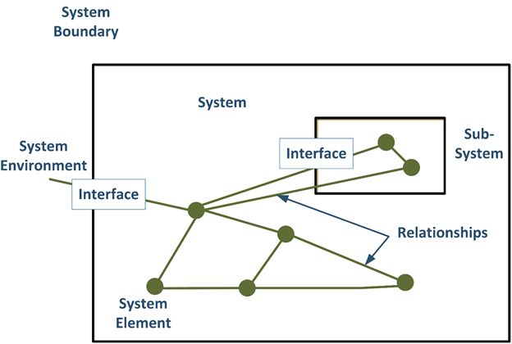
[Deepak, General Systems Theory, Wikimedia]

Slide 65
Information Gathering
Session 1
Achieving contextual understanding of a dataset is crucial.
Concretely, how does this understanding come about?
It can be reached through:
field trips
interviews with subject matter experts (SMEs)
readings/viewings
data exploration (even just trying to obtain or gain access to the data can prove a major pain), etc.
DATA SCIENCE ESSENTIALS

Slide 66
Information Gathering
Session 1
Clients or stakeholders are not uniform entities – client data specialists and SMEs may resent the involvement of analysts (external and/or internal).
Information gathering provides analysts the opportunity to show that everyone is pulling in the same direction, by:
asking meaningful questions
taking a genuine interest in the SMEs’/clients’ experiences
acknowledging everyone’s ability to contribute
A little tact goes a long way when it comes to information gathering.
DATA SCIENCE ESSENTIALS

Slide 67
Thinking in Systems Terms
Session 1
A system is made up of objects with properties that can change over time.
Within the system, there are actions and evolving properties, i.e., processes.
We understand how various aspects of the world interact with one another by carving chunks corresponding to the aspects and define their boundaries.
Working with other intelligences requires a shared understanding of what is being studied.
Objects themselves have various properties.
DATA SCIENCE ESSENTIALS

Slide 68
Thinking in Systems Terms
Session 1
Natural processes generate/destroy objects, and change the properties of these objects over time.
We observe, quantify, and record values of these properties at particular points in time.
Observations are used to capture the underlying reality to an acceptable degree of accuracy and error, but … even the best system model only ever provides an approximation of the situation under analysis.
With luck, experience, foresight, these approximations might be valid.
DATA SCIENCE ESSENTIALS

Slide 69
Identifying Gaps in Knowledge
Session 1
A gap in knowledge is identified when we realize that what we thought we knew about a system proves incomplete (or blatantly false).
Causes:
naı̈veté vis-à-vis the situation being modeled
nature of the project under consideration
With too many moving parts, unrealistic objectives, distance from pipeline, knowledge gaps cannot be avoided (although they also occur with small, well-organized, easily contained projects).
DATA SCIENCE ESSENTIALS

Slide 70
Identifying Gaps in Knowledge
Session 1
Knowledge gaps might occur repeatedly, at any moment in the process:
data cleaning
data consolidation
data analysis
even during communication of the results (!)
When faced with a knowledge gap, be flexible:
go back
ask questions
modify the system representation as often as is necessary
It is preferable to catch these gaps early on in the process (obviously).
DATA SCIENCE ESSENTIALS

Slide 71
Conceptual Models
Session 1
Conceptual models are built using methodical investigation tools:
diagrams
structured interviews
structured descriptions, etc.
Data scientists should beware implicit conceptual models (knowledge gaps).
It is preferable to err on the side of “too much conceptual modeling”, but remember that “every model is wrong; some models are useful” [G.E. Box].
It is OK to build better models in an iterative manner.
DATA SCIENCE ESSENTIALS

Slide 72
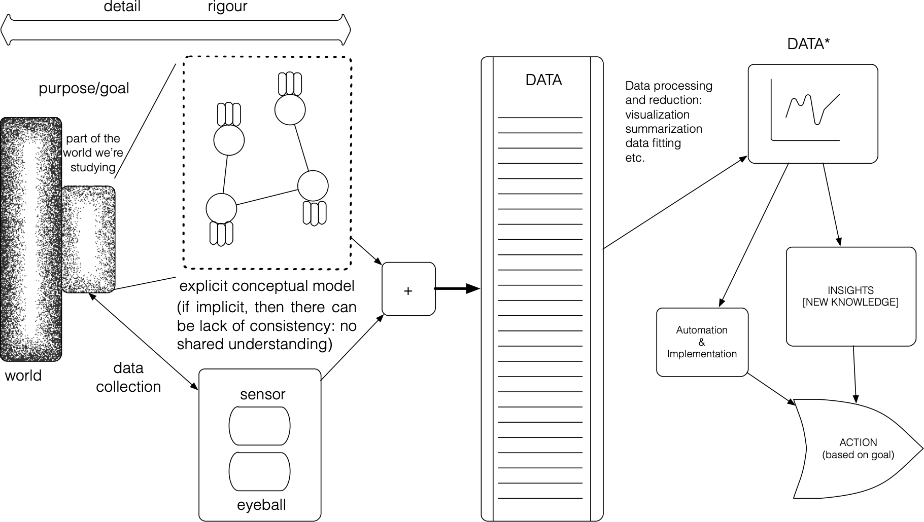
Conceptual Models
Session 1
Conceptual model
are not implemented as a scale-model or computer code
exist only conceptually, often in the form of a diagram/verbal description of a system – boxes and arrows, mind maps, lists, definitions
Focus is on:
possible states (not specific behaviour)
object types, not specific instances; the goal is abstraction
DATA SCIENCE ESSENTIALS

Slide 73
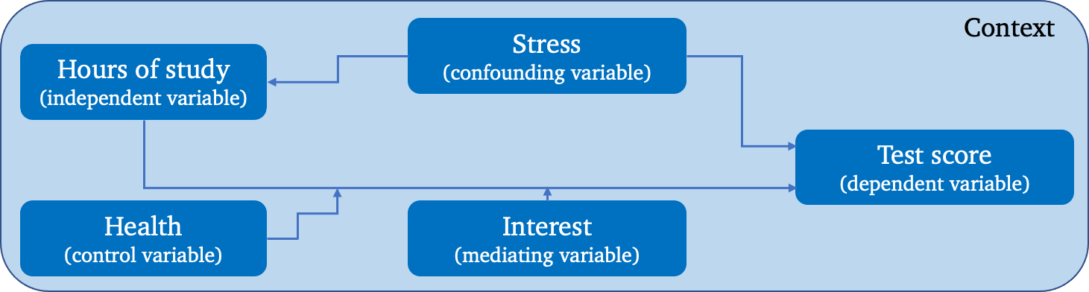
Conceptual Models
Session 1
In practice, we must first select a system for the task at hand, then generate a conceptual model that encompasses:
relevant and key objects (abstract or concrete);
properties of these objects, and their values;
relationships between objects (part-whole, is-a, object-specific, one-to-many), and
relationships between properties across instances of an object type.
A simplistic example describing a supposed relationship between a presumed cause (hours of study) and a presumed effect (test score).
DATA SCIENCE ESSENTIALS

Slide 74
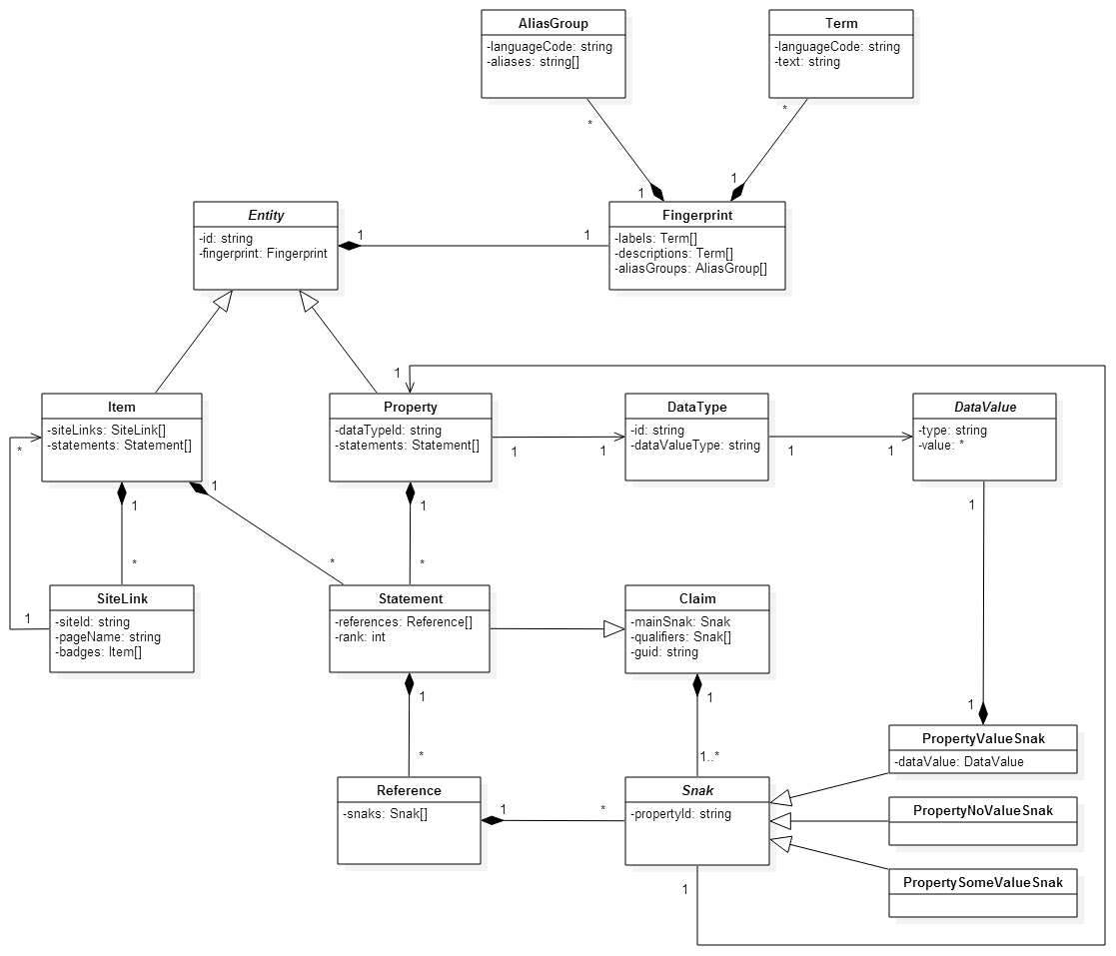
Formal Conceptual Model
Session 1
Conceptual modeling turn implicit conceptual models into explicit and tangible models.
It provides opportunities to examine and explore ideas and assumptions.
Various efforts have been made to formalize conceptual modelling:
UML (Universal Modelling Language)
Entity Relationship (ER) Models
DATA SCIENCE ESSENTIALS

Slide 75
Relating Data to the System
Session 1
Is the collected and analyzed data useful to understand the system? This question can best be answered if we understand:
how the data is collected
the approximate nature of both data and system
what the data represents (observations and features)
Is the combination of system and data sufficient to understand the situation under consideration? Difficult to answer in practice.
If the data, the system, and the real world are out of alignment, any data insight drawn from modeling and analysis might ultimately prove useless.
DATA SCIENCE ESSENTIALS

Slide 76
Cognitive Biases
Session 1
Cognitive biases have an impact on how we construct models and look for patterns in the data:
Anchoring Bias causes us to rely too heavily on the first piece of information we are given about a topic
Availability Heuristic describes our tendency to use information that comes to mind quickly and easily when making decisions about the future
Bandwagon Effect refers to our habit of adopting certain behaviours or beliefs because many others do the same
Choice-Supporting Bias causes us to view our actions in a positive light, even if they are flawed
Clustering Illusion refers to our tendency to see patterns in random events
Confirmation Bias describes our tendency to notice, focus on, and give greater credence to evidence that fits with our existing beliefs
Conservation Bias occurs when we favour prior evidence over new information
Ostrich Effect describes how people often avoid negative information, including feedback that helps them monitor their goal progress
DATA SCIENCE ESSENTIALS

Slide 77
Cognitive Biases
Session 1
Outcome Bias refers to judging a decision on the outcome, rather than on why it was made
Overconfidence causes us to take greater risks in our daily lives
Pro-innovation Bias occurs when proponents of a technology overvalue its usefulness and undervalue its limitations
Recency Bias occurs when we favour new information over prior evidence
Salience Bias describes our tendency to focus on items or information that are more noteworthy while ignoring those that do not grab our attention
Survivorship Bias is a cognitive shortcut that occurs when a visible successful subgroup is mistaken as an entire group
Zero-Risk Bias relates to our preference for absolute certainty
Other biases:
base rate fallacy, bounded rationality, category size bias, commitment bias, Dunning-Kruger effect, framing effect, hot-hand fallacy, IKEA effect, illusion of explanatory depth, illusion of validity, illusory correlations, look-elsewhere effect, optimism effect, planning fallacy, response bias, selective perception, etc.
DATA SCIENCE ESSENTIALS

Slide 78
Suggested Reading
Session 1
Data Understanding, Data Analysis, Data Science Data Science Basics Conceptual Frameworks for Data Work
Three Modeling Strategies
Information Gathering
Cognitive Biases
Conceptual Frameworks
DATA SCIENCE ESSENTIALS

Slide 79
Exercises
Session 1
Consider the following situation: you are away on business and you forgot to hand in a very important (and urgently required) architectural drawing to your supervisor before leaving. Your office will send an intern to pick it up in your living space. How would you explain to them, by phone, how to find the document? If the intern has previously been in your living space, if their living space is comparable to yours, or if your spouse is at home, the process may be sped up considerably, but with somebody for whom the space is new (or someone with a visual impairment, say), it is easy to see how things could get complicated. Time is of the essence – you and the intern need to get the job done correctly as quickly as possible. What is your strategy?
Translate the cognitive biases to analytical contexts. What cognitive biases are you, your team, and your organization most susceptible to? Least?
Conceptual Frameworks
DATA SCIENCE ESSENTIALS

Slide 80
Session 2
DATA SCIENCE ESSENTIALS

Slide 81
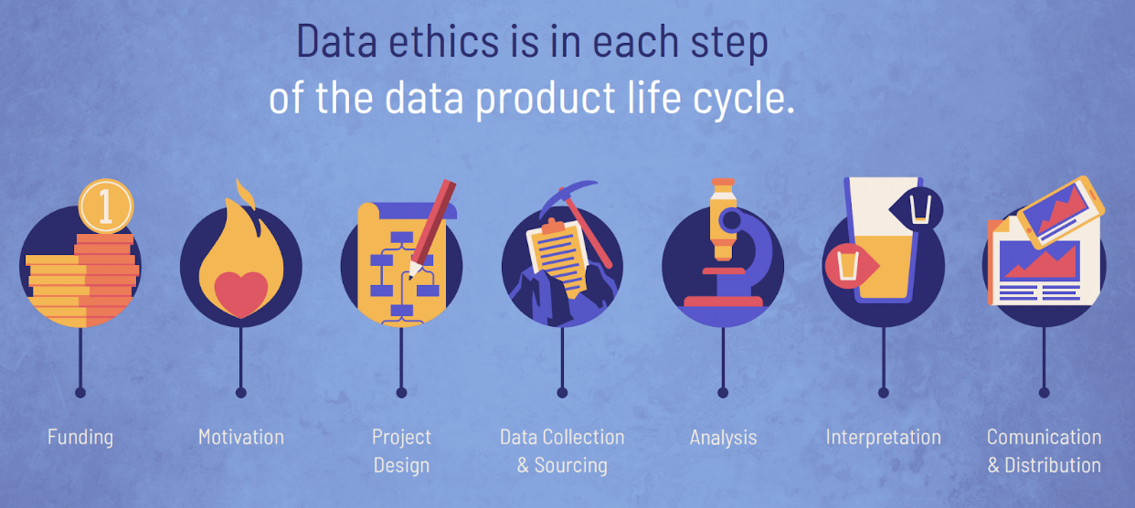
4. Data Science Ethics
Session 2
DATA SCIENCE ESSENTIALS

Slide 82
The Need for Ethics
Session 2
In most empirical disciplines, ethics are introduced early in the educational process and end up playing a crucial role in researchers’ activities.
Data scientists who come to the field by way of mathematics, statistics, computer science, economics, or engineering, however, are less likely to have encountered ethical research boards or formal ethics training.
Discussions on ethical matters are often tabled in favour of pressing technical or administrative considerations when faced with hard deadlines.
But the current deadline is replaced by another deadline, and then by another one, with the end result being that the conversation may never take place.
DATA SCIENCE ESSENTIALS

Slide 83
The Need for Ethics
Session 2
When large-scale data collection first became possible, there was a ‘Wild West’ mentality to its use: everything was allowed as long as it was feasible.
Modern data science has professional codes of conduct
outlining responsible ways to practice data science
legitimate rather than fraudulent, ethical rather than unethical.
This shifts added responsibility to data scientists, but provides protection from clients/employers who want them to carry analysis in questionable ways.
DATA SCIENCE ESSENTIALS

Slide 84
The Need for Ethics
Session 2
Recent focus on data ethics does not seem to have slowed breaches:
Volkswagen
Whole Foods Markets
General Motors
Cambridge Analytica
Amazon
Ashley Madison
DATA SCIENCE ESSENTIALS

Slide 85
What is/are Ethics?
Session 2
Ethics refers to the study and definition of right and wrong conduct:
in general
applied in specific circumstances
Ethics is not (necessarily) the same as:
social convention
religious beliefs
laws
DATA SCIENCE ESSENTIALS

Slide 86
What is/are Ethics?
Session 2
In the West, ethical theories are used to frame debates around ethical issues:
Golden rule: do unto others as you would have them do unto you
Consequentialism: the end justifies the means
Utilitarianism: act in order to maximize positive effect
Moral Rights: act to maintain and protect the fundamental rights and privileges of the people affected by actions
Justice: distribute benefits and harm among stakeholders in a fair, equitable, impartial way
DATA SCIENCE ESSENTIALS

Slide 87
What is/are Ethics?
Session 2
But humans subscribe to a wide variety of ethical codes/cultures, including:
Confucianism
Taoism
Buddhism
Shinto
Ubuntu
Te Ara Tika (Maori)
etc.
It is easy to imagine contexts in which any of these would be better-suited to the task at hand –remember to inquire and to heed the answers.
DATA SCIENCE ESSENTIALS

Slide 88
Ethics and Data Science
Session 2
How might these ethical theories apply to data analysis?
who, if anyone, owns data?
are there limits to how data can be used?
are there value-biases built into certain analytics?
are there categories that should never be used in analyzing personal data?
should data be publicly available to all researchers?
The answers depend on a number of factors. To give you an idea of some of the complexities, let us the first question: who, if anyone, owns data?
DATA SCIENCE ESSENTIALS

Slide 89
Ethics and Data Science
Session 2
Is it the data analysts who transform the data’s potential into usable insights?
Is it the data collectors who have a copy and make the work possible?
Is it the sponsors or employers who made the process economically viable?
In some instances, the law may chime in as well. Anybody else?
This simple question is not easily answered; it’s on a case-by-case basis.
Hidden truth: there is more to data analysis than just data analysis.
DATA SCIENCE ESSENTIALS

Slide 90
Ethics and Data Science
Session 2
Similar challenge for open data ( “pro” vs. “anti” both have strong arguments).
General principle of data analysis: eschew the anecdotal for the general. Sound, as focus on specific observations can obscure the full picture.
But data points are not just marks on paper or bytes on the cloud. Decisions made on the basis of data science may affect living beings in negative ways. It cannot be ignored that outlying individuals and minority groups often suffer disproportionately at the hands of so-called evidence-based decisions.
First Nations Principles of OCAP (Ownership, Control, Access, Possession).
DATA SCIENCE ESSENTIALS

Slide 91
Best Practices
Session 2
“Do No Harm”: data collected from an individual should not be used to harm the individual.
Informed Consent:
Individuals must agree to the collection and use of their data
Individuals must have a real understanding of what they are consenting to, and of possible consequences for them and others
Respect “Privacy”: excessively hard to maintain in the age of constant trawling of the Internet for personal data.
DATA SCIENCE ESSENTIALS

Slide 92
Best Practices
Session 2
Keep Data Public: data should be kept public (all? most? any?).
Opt-In/Opt-Out: Informed consent requires the ability to opt out.
Anonymize Data: removal of id fields from data prior to analysis.
“Let the Data Speak”:
no cherry picking
importance of validation (more on this later)
correlation and causation (more on this later, too)
repeatability
DATA SCIENCE ESSENTIALS

Slide 93
The Good, the Bad, and the Ugly
Session 2
Data projects could whimsically be classified as good, bad or ugly, either from a technical or from an ethical standpoint (or both).
good projects increase knowledge, can help uncover hidden links, etc., as harmlessly as possible
bad projects can lead to bad decisions, which can in turn decrease the public’s confidence and potentially harm some individuals
ugly projects are, flat out, unsavoury applications; they are poorly executed from a technical perspective, or put a lot of people at risk; these (and similar approaches/studies) should be avoided
DATA SCIENCE ESSENTIALS

Slide 94
The Good, the Bad, and the Ugly
Session 2
Good:
P. A. B. Bien Nicholas AND Rajpurkar, “Deep-learning-assisted diagnosis for knee magnetic resonance imaging: Development and retrospective validation of MRNet,” PLOS Medicine, vol. 15, no. 11, pp. 1–19, 2018, doi: 10.1371/journal.pmed.1002699.
BeauHD, “Google AI claims 99 percent accuracy in metastatic breast cancer detection,” Slashdot.com, Oct. 2018.
Columbia University Irving Medical Center, “Data scientists find connections between birth month and health,” Newswire.com, Jun. 2015.
DATA SCIENCE ESSENTIALS

Slide 95
The Good, the Bad, and the Ugly
Session 2
Bad:
Indiana University, “Scientists use Instagram data to forecast top models at New York Fashion Week,” Science Daily, Sep. 2015.
D. Wakabayashi, “Firm led by Google veterans uses A.I. to ‘nudge’ workers toward happiness,” New York Times, Dec. 2018.
N. Cohn, “How one 19-year-old illinois man is distorting national polling averages,” The Upshot, 2016.
DATA SCIENCE ESSENTIALS

Slide 96
The Good, the Bad, and the Ugly
Session 2
Ugly:
J. Dastin, “Amazon scraps secret AI recruiting tool that showed bias against women,” Reuters, Oct. 2018.
I. Johnston, “AI robots learning racism, sexism and other prejudices from humans, study finds,” The Independent, Apr. 2017.
M. Judge, “Facial-recognition technology affects African-Americans more often,” The Root, 2016.
M. Kosinski and Y. Wang, “Deep neural networks are more accurate than humans at detecting sexual orientation from facial images,” Journal of Personality and Social Psychology, vol. 114, no. 2, pp. 246–257, Feb. 2018.
DATA SCIENCE ESSENTIALS

Slide 97
Suggested Reading
Session 2
Data Understanding, Data Analysis, Data Science Data Science Basics Ethics in the Data Science Context
The Need for Ethics
What Is/Are Ethics?
Ethics and Data Science
Guiding Principles
Data Science Ethics
DATA SCIENCE ESSENTIALS

Slide 98
Exercises
Session 2
Research the recent data ethics scandals involving Volkswagen, Amazon, Whole Foods Markets, Cambridge Analytica, Ashley Madison, General Motors, or any other organization. What transpired? Who was affected? What were the consequences to the general public, the organization, the data community? How could it have been avoided?
Establish a statement of ethics for your data work. Are there areas that you are unwilling to work on?
Data Science Ethics
DATA SCIENCE ESSENTIALS

Slide 99
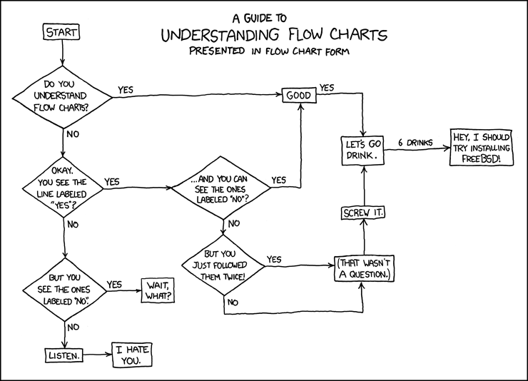
5. Analytics Workflows
Session 2
DATA SCIENCE ESSENTIALS

Slide 100
Analytics Workflows
Session 2
You are probably sick of discussions about context and would rather move to data analysis proper.
Very soon. One last thing, then: the project context.
Data science is more than just the analysis of data; this is apparent when we look at the typical steps involved in a data science project.
Data analysis pieces take place within this larger project context, as well as in the context of a larger technical infrastructure or pre-existing system.
DATA SCIENCE ESSENTIALS

Slide 101
The “Analytical” Method
Session 2
As with the scientific method, there is a “step-by-step” guide to data analysis:
statement of objective
data collection
data clean-up
data analysis/analytics
dissemination
documentation
Notice that data analysis only makes up a small segment of the entire flow.
In practice, the process is quite often messy, with steps added in and taken out of the sequence, repetitions, re-takes, etc.
Surprisingly, it tends to work… when conducted correctly.
DATA SCIENCE ESSENTIALS

Slide 102
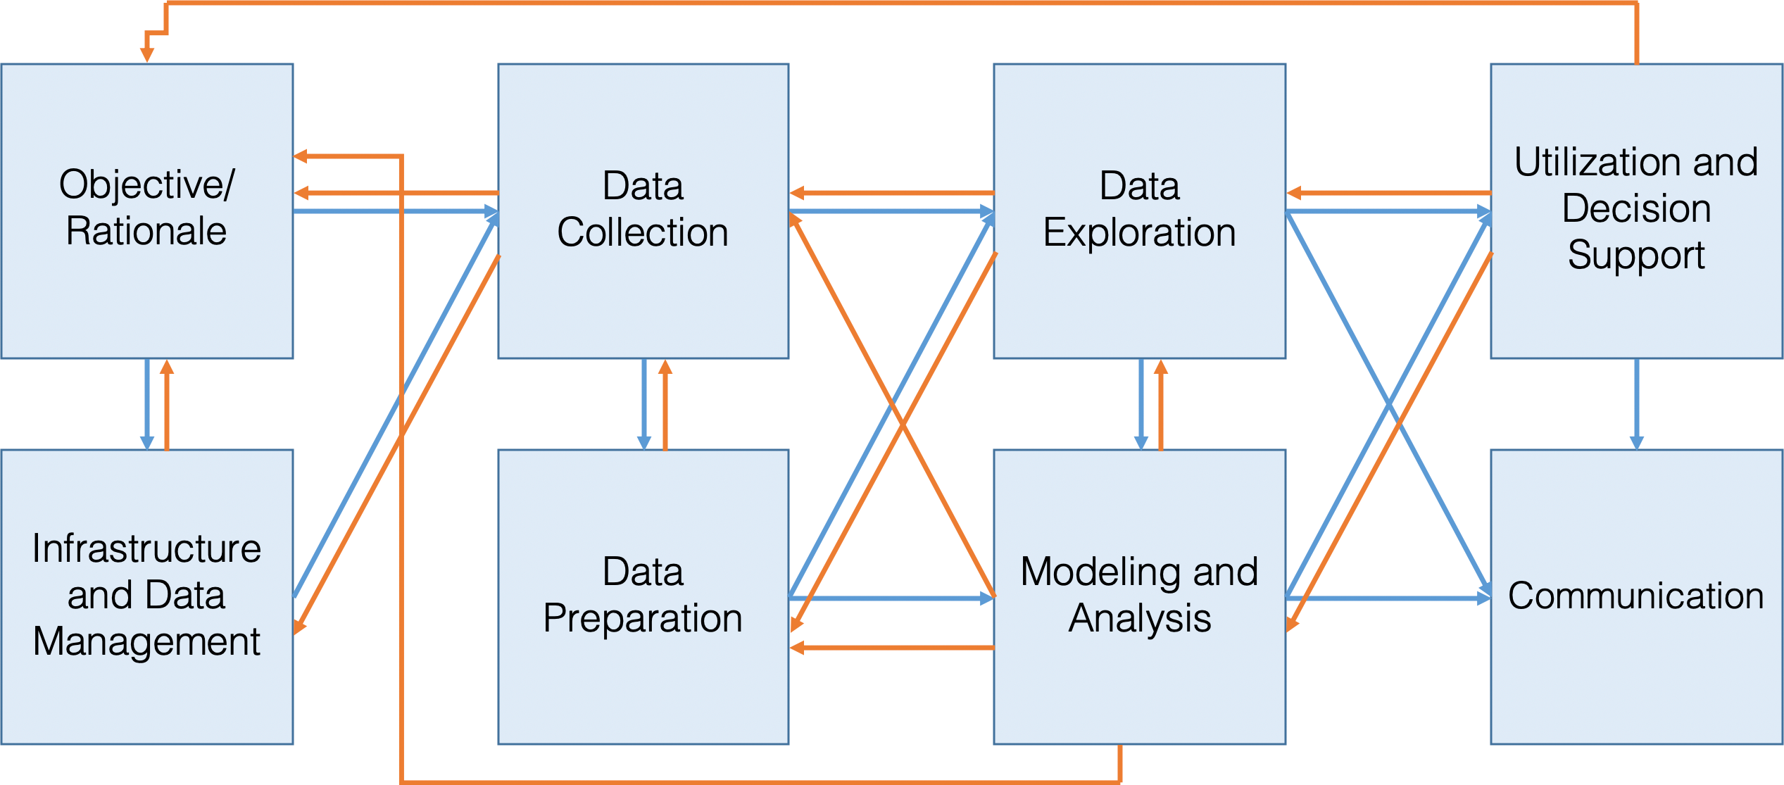
The “Analytical” Methods
Session 2
DATA SCIENCE ESSENTIALS

Slide 103
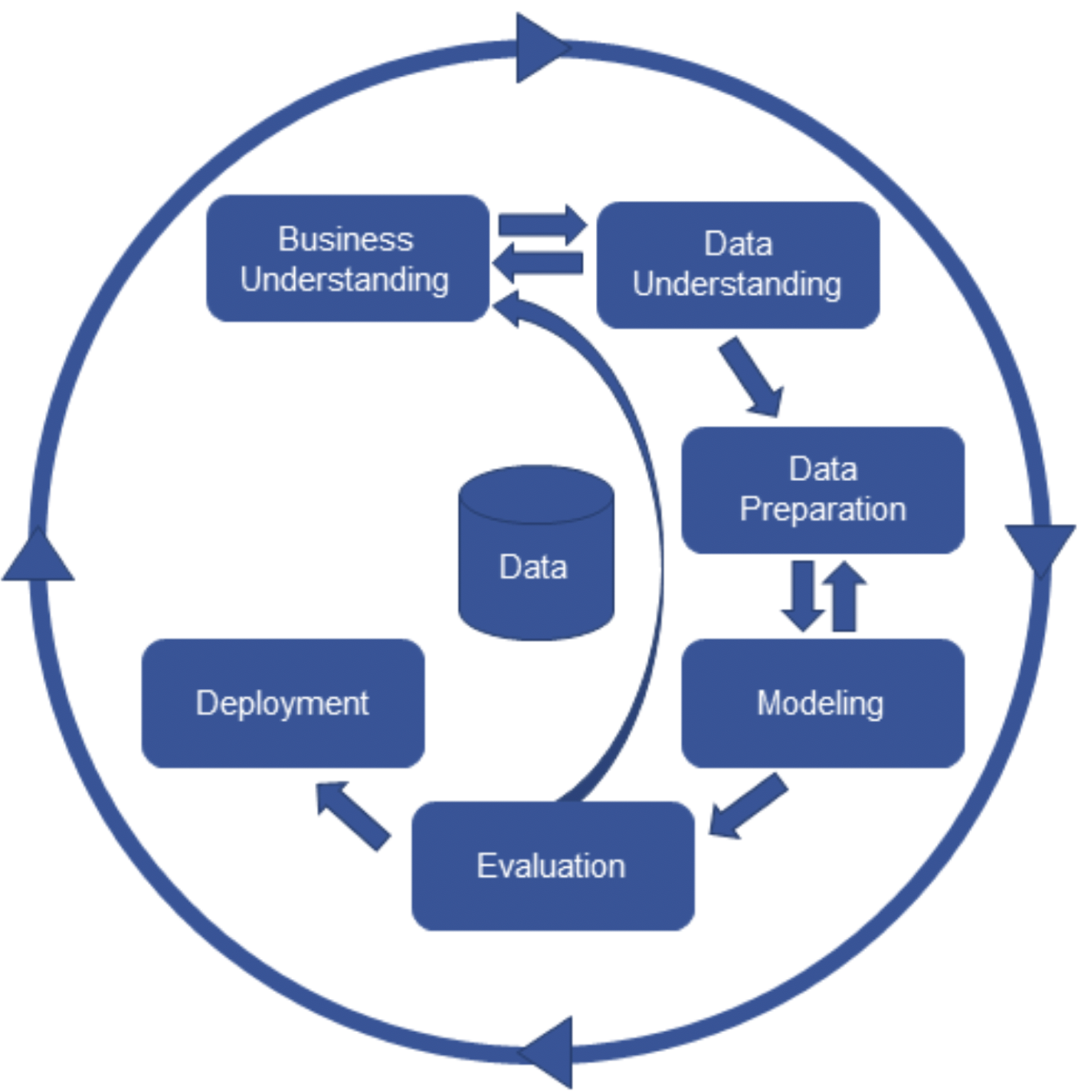
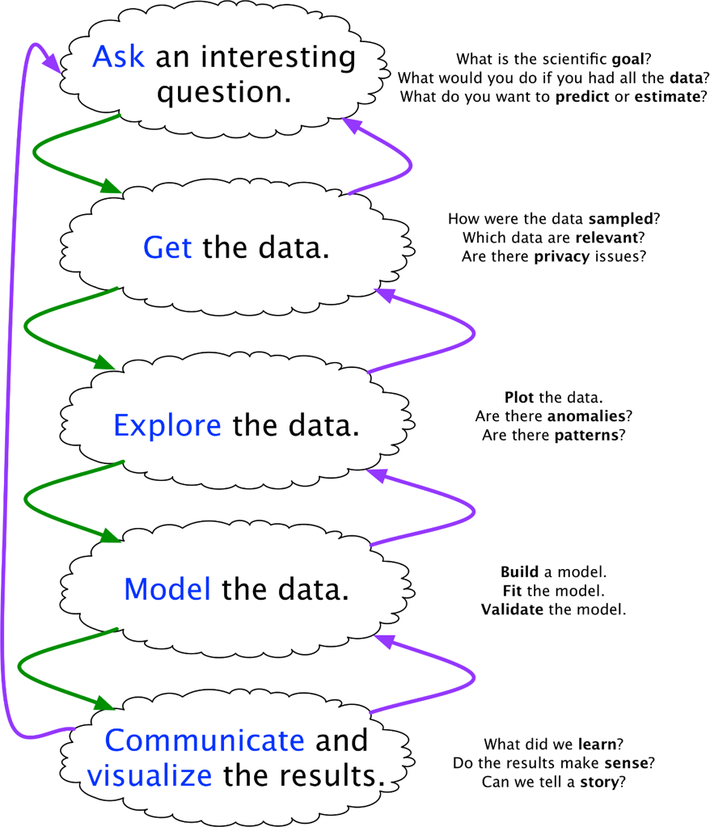
The “Analytical” Methods
Session 2
[CRISP-DM framework (left); Blitzstein and Pfister’s data science workflow (right)]
DATA SCIENCE ESSENTIALS

Slide 104
The “Analytical” Methods
Session 2
In practice, data analysis is often corrupted by:
lack of clarity
mindless rework
blind hand-off to IT
failure to iterate
All approaches have a common core
data science projects are iterative
(often) non-sequential.
Helping stakeholders recognize this central truth makes it easier for data scientists to:
plan the data science process
obtain actionable insights
Take-away: there is a lot to consider in advance of modeling and analysis
data analysis is not just about data analysis.
DATA SCIENCE ESSENTIALS

Slide 105
Data Collection
Session 2
Data enters the data science pipeline by being collected.
There are various ways to do this:
data may be collected in a single pass
it may be collected in batches
it may be collected continuously
The mode of entry may have an impact on the subsequent steps, including how frequently models, metrics, and other outputs are updated.
DATA SCIENCE ESSENTIALS

Slide 106
Data Storage
Session 2
Once it is collected, data must be stored.
Choices related to storage (and processing) must reflect:
how the data is collected (mode of entry)
how much data there is to store and process (small vs. big)
the type of access and processing that will be required (how fast, how much, by whom)
Stored data may go stale (figuratively and literally); regular data audits are recommended.
DATA SCIENCE ESSENTIALS

Slide 107
Data Processing
Session 2
The data must be processed before it can be analyzed.
The key point is that raw data has to be converted into a format that is amenable to analysis, by:
identifying invalid, unsound, and anomalous entries
dealing with missing values
transforming the variables so that they meet the requirements of the selected algorithms
The analysis itself is almost anti-climactic: simply run the selected methods or algorithms on the processed data.
DATA SCIENCE ESSENTIALS

Slide 108
Modeling
Session 2
Data science teams should know:
data cleaning
descriptive statistics and correlation
probability and inferential statistics
regression analysis
classification and supervised learning
clustering and unsupervised learning
anomaly detection and outlier analysis
big data/high-dimensional data analysis
stochastic modeling, etc.
These only represent a small slice of the analysis pie (see earlier slide).
No one analyst/data scientist could master all (or even a majority of them) at any moment, but that is one of the reasons why data science is a team activity.
DATA SCIENCE ESSENTIALS

Slide 109
Model Assessment and Life After Analysis
Session 2
Before applying findings, we must first confirm that the model is reaching valid conclusions about the system of interest.
Analytical processes are reductive: raw data is transformed into a small(er) numerical summaries, which we hope is related to the system of interest.
Data science methodologies include an assessment phase
analytical sanity check: is anything out of alignment?
Beware the tyranny of past success: even if the analytical approach has been vetted and has given useful answers in the past, it may not always do so.
DATA SCIENCE ESSENTIALS

Slide 110
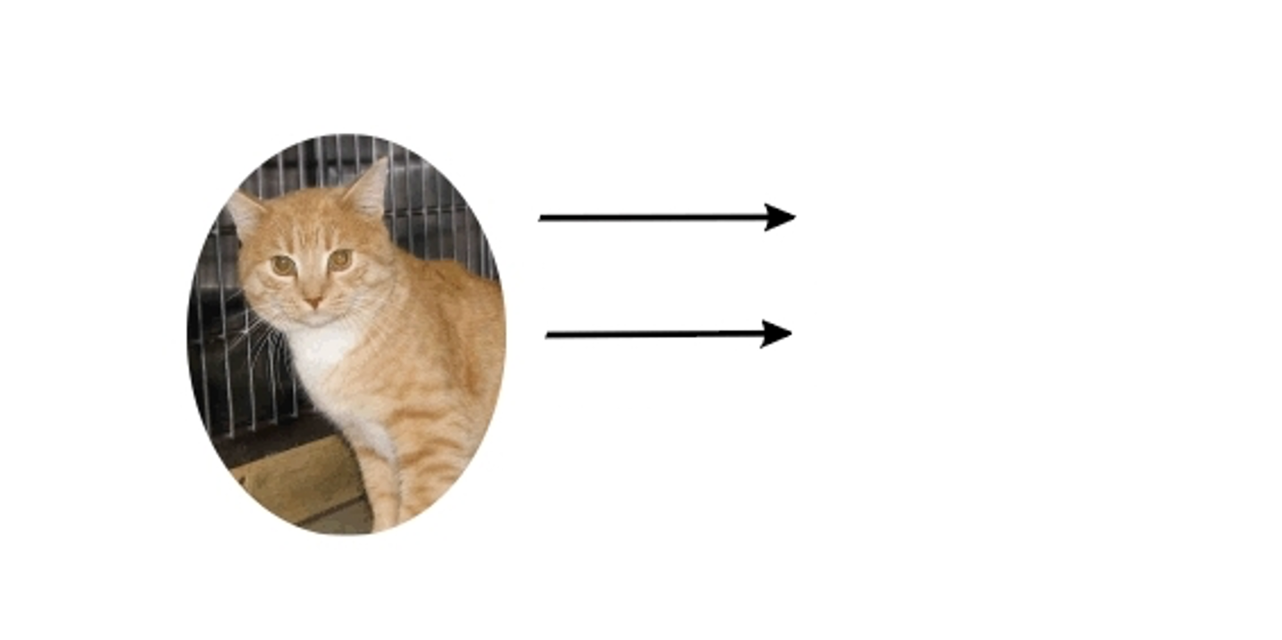

Session 2
[http://dailycatdrawings.tumblr.com; #309]
Real World
Model
Theory
Identification of details relevant to description and translation of real-world objects into model variables

Slide 111
Model Assessment and Life After Analysis
Session 2
When an analysis or model is ‘released into the wild’, it often takes on a life of its own. When it inevitably ceases to be current, there may be little that data scientists can do to remedy the situation.
How do we determine if the current data model is:
out-of-date?
no longer useful?
how long does it take a model to react to a conceptual shift?
Regular audits can be used to answer these questions.
DATA SCIENCE ESSENTIALS

Slide 112
Model Assessment and Life After Analysis
Session 2
Data scientists rarely have full control over model dissemination.
results may be misappropriated, misunderstood, shelved, or failed to be updated
can conscientious analysts do anything to prevent this?
There is no easy answer: analysts should not only focus on the analysis, but also recognize opportunities that arises to educate stakeholders on the importance of these auxiliary concepts.
Due to analytic decay, the last step in the analytical process is not a static dead end, but an invitation to re-iterate to the beginning of the process.
DATA SCIENCE ESSENTIALS

Slide 113
Data Pipelines (First Pass)
Session 2
In the service delivery context, the data analysis process is implemented as an automated data pipeline to enable automatic runs.
Data pipelines usually consist of 9 components (5 stages and 4 transitions):
data collection
data storage
data preparation
data analysis
data presentation
DATA SCIENCE ESSENTIALS

Slide 114
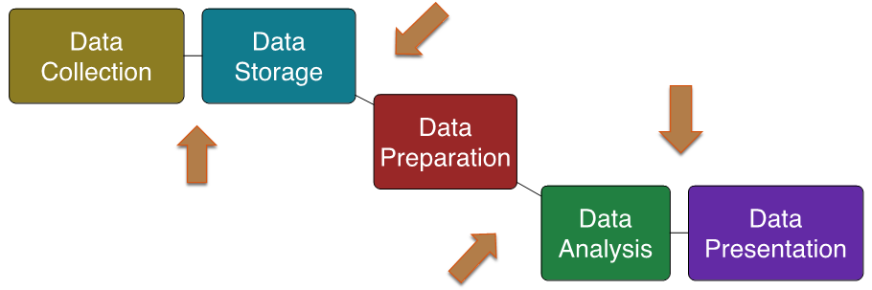
Data Pipelines (First Pass)
Session 2
Each components must be designed and then implemented.
Typically, at least one data analysis pass process has to be done manually before the implementation is completed.
DATA SCIENCE ESSENTIALS

Slide 115
Suggested Reading
Session 2
Data Understanding, Data Analysis, Data Science Data Science Basics Analytics Workflows
The "Analytical" Methods
Data Collection, Storage, Processing, and Modeling
Model Assessment and Life After Analysis
Automated Data Pipelines
Analytics Workflows
DATA SCIENCE ESSENTIALS

Slide 116
Exercises
Session 2
Install R / RStudio (Posit), and packages from the list the instructor will provide.
Test the installation with examples from the Programming Primer (sections 2 – 4) to make sure that the software performs as expected.
Analytics Workflows
DATA SCIENCE ESSENTIALS

Slide 117
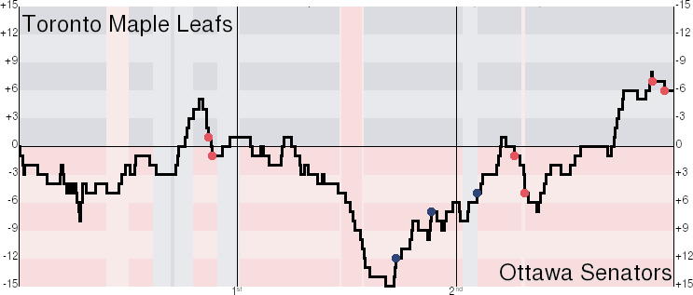
6. Getting Insight From Data
Session 2
DATA SCIENCE ESSENTIALS

Slide 118



Analytics Modes
Session 2
Descriptive
Diagnostic
Predictive
Prescriptive
b
c
a
Show what happened
Explain why something happened
Guess what will happen
Suggest what should happen
Low Value
Low Difficulty
High Value
High Difficulty
DATA SCIENCE ESSENTIALS

Slide 119
Asking the Right Questions
Session 2
Data science is about asking and answering questions:
Analytics: “How many clicks did this link get?”
Data Science: “Based on this user’s previous purchasing history, can I predict what links they will click on the next time they access the site?”
Data mining/science models are usually predictive (not explanatory): they show connections, but don't reveal why these exist.
Warning: not every situation calls for data science, artificial intelligence, machine learning, statistics, or analytics.
DATA SCIENCE ESSENTIALS

Slide 120
The Wrong Questions
Session 2
Too often, analysts are asking the wrong questions:
questions that are too broad or too narrow
questions that no amount of data could ever answer
questions for which data cannot reasonably be obtained
The best-case scenario is that stakeholders will recognize the answers as irrelevant.
The worst-case scenario is that they will erroneously implement policies or make decisions based on answers that have not been identified as misleading or useless.
DATA SCIENCE ESSENTIALS

Slide 121
Roadmap to Framing Questions
Session 2
Understand the problem (opportunity vs problem)
What initial assumptions do I have about the situation?
How will the results be used?
What are the risks and/or benefits of answering this question?
What stakeholder questions might arise based on the answer(s)?
Do I have access to the data necessary to answering this question?
How will I measure my ‘success’ criteria?
DATA SCIENCE ESSENTIALS
Notes:
Facebook vs day-to-day company

Slide 122
Yes/No Trap
Session 2
Examples of bad questions:
Are our revenues increasing over time? Has it increased year-over-year?
Are most of our customers from this demographic?
Does this project have valuable ambitions to the broader department?
How great is our hard-working customer success team?
How often do you triple check your work?
Examples of good questions:
What’s the distribution of our revenues over the past three months?
Where are our top 5 high-spending cohorts from?
What are the different benefits of pursuing this project?
What are three good and bad traits of our customer success team?
Do you tend to do quality assurance testing on your deliverables?
DATA SCIENCE ESSENTIALS
Notes:
Facebook vs day-to-day company

Slide 123
Question Audit Checklist
Session 2
Did I avoid creating any yes/no questions?
Would anyone in my team/department understand the question irrespective of their backgrounds?
Does the question need more than one sentence to express?
Is the question ‘balanced’ - scope is not too broad that the question will never truly be answered, or too small that the resulting impact is minimal?
Is the question being skewed to what may be easier to answer for my/my team’s particular skillset(s)?
DATA SCIENCE ESSENTIALS

Slide 124
Contingency/Pivot Tables
Session 2
Contingency table: examines the relationship between two categorical variables via their relative (cross-tabulation).
Pivot table: a table generated by applying operations (sum, count, mean, etc.) to variables, possibly based on another (categorical) variable.
Contingency tables are special cases of pivot tables.
Type | Count | Signal avg | Signal stdev
Blue | 4 | 4.04 | 0.98
Green | 1 | 4.93 | N.A.
Orange | 4 | 5.37 | 1.60
 | Large | Medium | Small
Window | 1 | 32 | 31
Door | 14 | 11 | 0
DATA SCIENCE ESSENTIALS

Slide 125
Analysis Through Visualization
Session 2
Analysis (broad definition):
identifying patterns or structure
adding meaning to these patterns or structure by interpreting them in the context of the system.
Option 1: use analytical methods to achieve this.
Option 2: visualize the data and use the brain’s analytic power (perceptual) to reach meaningful conclusions about these patterns.
DATA SCIENCE ESSENTIALS

Slide 126
Numerical Summaries
Session 2
In a first pass, a variable can be described along 2 dimensions: centrality & spread (skew and kurtosis are also used sometimes).
Centrality measures include:
median, mean, mode (less frequently)
Spread (or dispersion) measures include:
standard deviation (sd), variance, quartiles, inter-quartile range (IQR), range (less frequently)
The median, range and the quartiles are easily calculated from ordered lists.
DATA SCIENCE ESSENTIALS

Slide 127
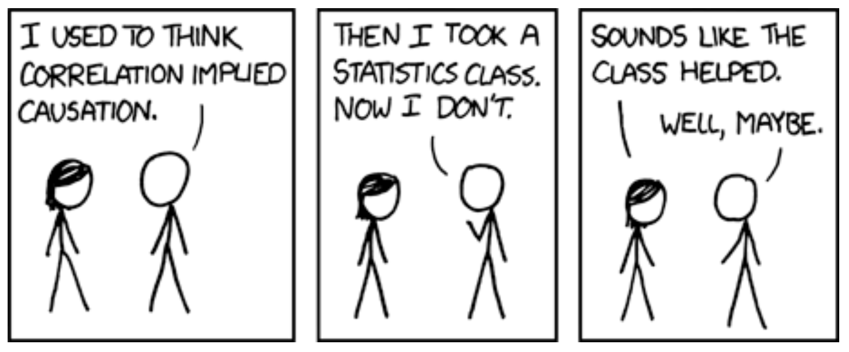
Correlation
Session 2
[https://xkcd.com/552]
Correlation doesn't imply causation, but it does waggle its eyebrows suggestively and gesture furtively while mouthing 'look over there'.
DATA SCIENCE ESSENTIALS

Slide 128
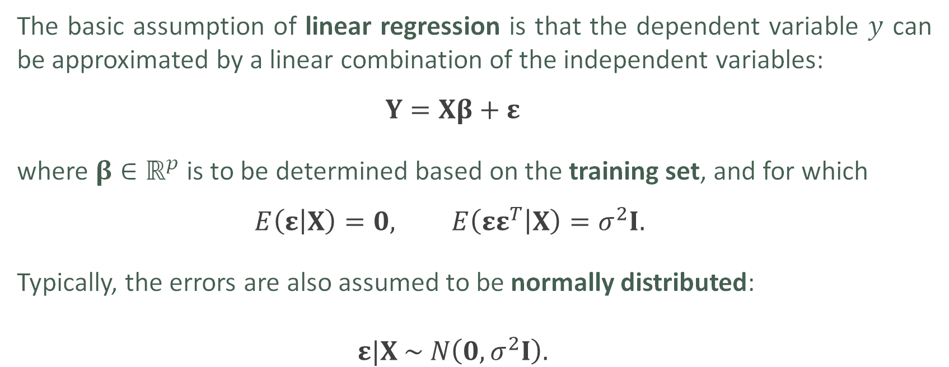
Linear Regression
Session 2
The basic assumption of linear regression is that the dependent variable $y$ can be approximated by a linear combination of the independent variables:
$$Y=Xβ+ε$$
where $β∈ℝ^{p}$ is to be determined based on the training set, and for which
$$E\left(ε | X\right)=0, E\left(εε^{T} | X\right)=σ^{2}I.$$
Typically, the errors are also assumed to be normally distributed:
$$ε|X \sim N\left(0, σ^{2}I\right).$$
DATA SCIENCE ESSENTIALS

Slide 129
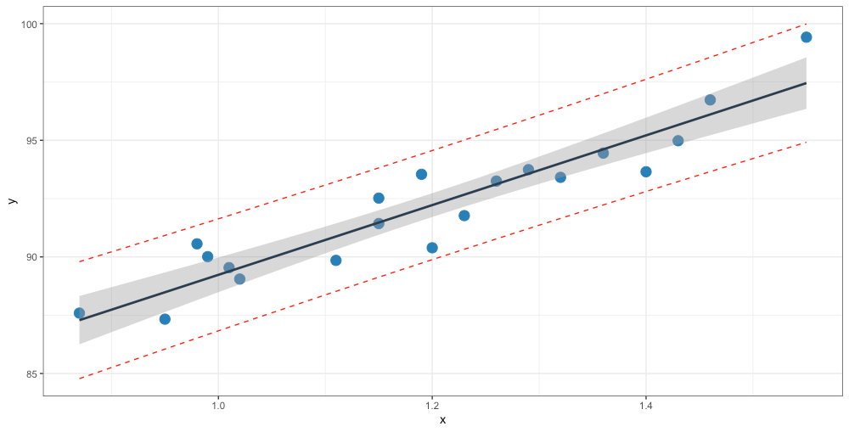
Session 2
$$\text{oxygen}=14.95 × \text{hydrocarbon}+74.28$$
oxygen
prediction interval for new responses
confidence interval for mean response
hydrocarbon
DATA SCIENCE ESSENTIALS

Slide 130
Machine Learning Tasks
Session 2
Classification and class probability estimation: which clients are likely to be repeat customers?
Clustering: do customers form natural groups?
Association rule discovery: what books are commonly purchased together?
Others:
profiling and behaviour description; link prediction; value estimation (how much is a client likely to spend in a restaurant); similarity matching (which prospective clients are similar to a company's best clients?); data reduction; influence/causal modeling, etc.
DATA SCIENCE ESSENTIALS

Slide 131
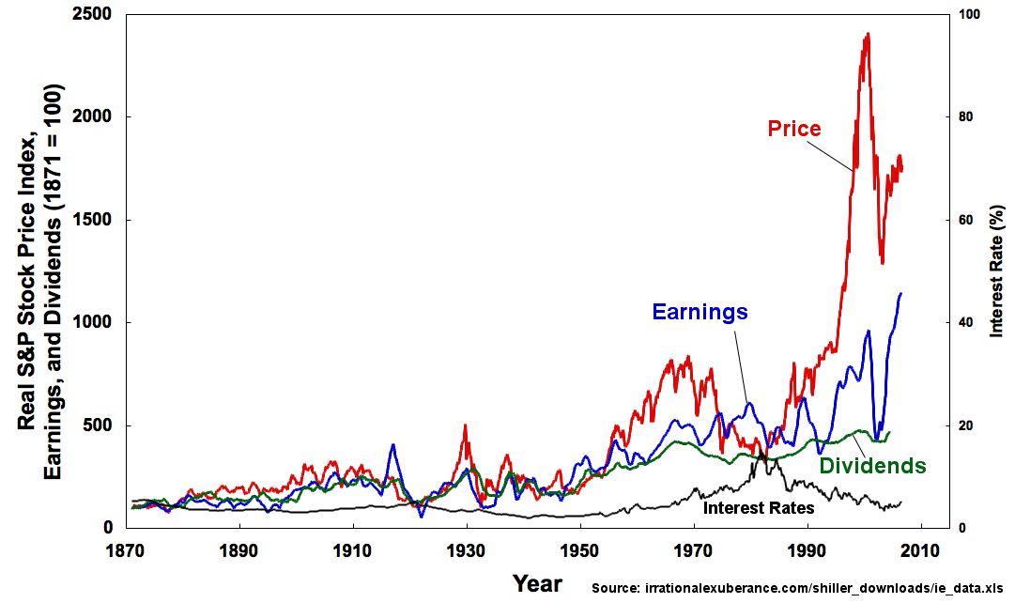
Time Series Analysis
Session 2
A simple time series:
has two variables: time + 2nd variable
the second variable is sequential
What is the pattern of behaviour of this second variable over time? Relative to other variables?
Can we use this to forecast the future behaviour of the variable ?
DATA SCIENCE ESSENTIALS

Slide 132

Anomaly Detection
Session 2
Anomaly: an unexpected, unusual, atypical or statistically unlikely event
Wouldn’t it be nice to have a data analysis pipeline that alerted you when things were out of the ordinary?
Many different analytic approaches to take!
clustering
classification
ensemble techniques, etc.
DATA SCIENCE ESSENTIALS

Slide 133
Suggested Reading
Session 2
Data Understanding, Data Analysis, Data Science Data Science Basics Getting Insight From Data
Asking the Right Questions
Basic Data Analysis Techniques
Common Statistical Procedures in R
Quantitative Methods
*Probability and Applications (advanced)
*Introductory Statistical Analysis (advanced)
*Survey Sampling (advanced)
*Regression Analysis (coming soon)
Getting Insight From Data
DATA SCIENCE ESSENTIALS

Slide 134
Exercises
Session 2
Do the exercise in Asking the Right Questions.
Recreate the examples of Common Statistical Procedures in R.
The file cities.txt contains population information about a country’s cities. A city is classified as “small” if its population is below 75K, as “medium” if it falls between 75K and 1M, and as “large” otherwise. Locate and load the file into the workspace of your choice. How many cities are there? How many are there in each group? Display summary population statistics for the cities, both overall and by group.
Getting Insight From Data
DATA SCIENCE ESSENTIALS

Slide 135
Session 3
DATA SCIENCE ESSENTIALS

Slide 136
Data Preparation
Session 3
DATA SCIENCE ESSENTIALS
DATA SCIENCE ESSENTIALS

Slide 137

7. Data Quality and Data Wrangling
Session 3
DATA SCIENCE ESSENTIALS

Slide 138
The Hot Mess
Session 3
“Data is messy, you know.” “Even after it’s been cleaned?” “Especially after it’s been cleaned.”
Data cleaning, processing, wrangling are essential aspects of data science projects; analysts may spend up to 80% of their time on data preparation.
DATA SCIENCE ESSENTIALS

Slide 139
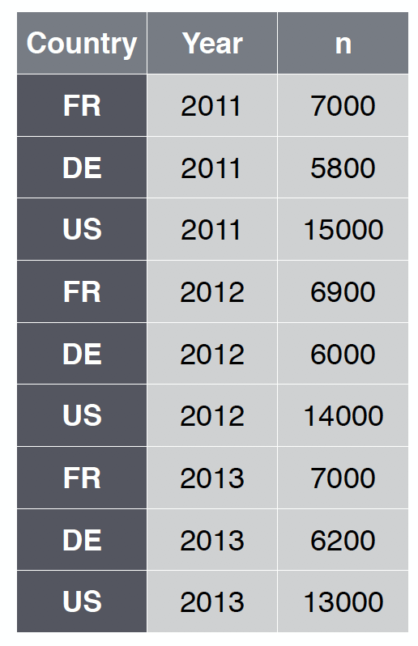
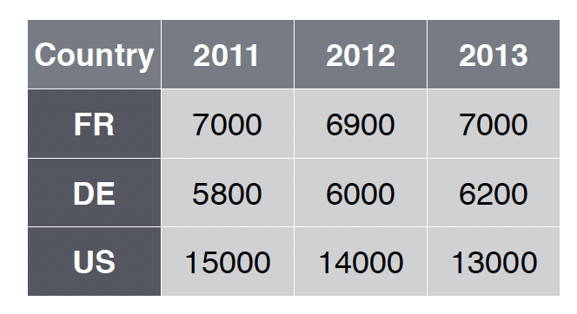
Data Wrangling and Tidy Data
Session 3
Tidy data has a specific structure:
each variable is in a single column
each observation is in a single row
each type of observational unit is in a single table
vs.
DATA SCIENCE ESSENTIALS

Slide 140
Data Wrangling Functionality
Session 3
Data wrangling functions should allow the analyst to:
extract a subset of variables from the data frame
extract a subset of observations from the data frame
sort the data frame along any combination of variables in increasing or decreasing order
to create new variables from existing variables
to create (so-called) pivot tables, by observation groups
database functionality (joins, etc.)
etc.
DATA SCIENCE ESSENTIALS

Slide 141
Approaches to Data Cleaning
Session 3
There are two philosophical approaches to data cleaning and validation:
methodical
narrative
The methodical approach consists of running through a check list of potential issues and flagging those that apply to the data.
The narrative approach consists of exploring the dataset and trying to spot unlikely and irregular patterns.
DATA SCIENCE ESSENTIALS

Slide 142
Approaches to Data Cleaning
Session 3
Methodical (syntax)
Pros: checklist is context-independent; pipelines easy to implement; common errors and invalid observations easily identified
Cons: may prove time-consuming; cannot identify new types of errors
Narrative (semantics)
Pros: process may simultaneously yield data understanding; false starts are (at most) as costly as switching to mechanical approach
Cons: may miss important sources of errors and invalid observations for datasets with high number of features; domain knowledge may bias the process by neglecting uninteresting areas of the dataset
DATA SCIENCE ESSENTIALS

Slide 143
Data Soundness
Session 3
The ideal dataset will have as few issues as possible with:
validity: data type, range, mandatory response, uniqueness, value, regular expressions
completeness: missing observations
accuracy and precision: related to measurement and data entry errors; target diagrams (accuracy as bias, precision as standard error)
consistency: conflicting observations
uniformity: are units used uniformly throughout?
Checking for data quality issues at an early stage can save headaches later in the analysis.
DATA SCIENCE ESSENTIALS

Slide 144
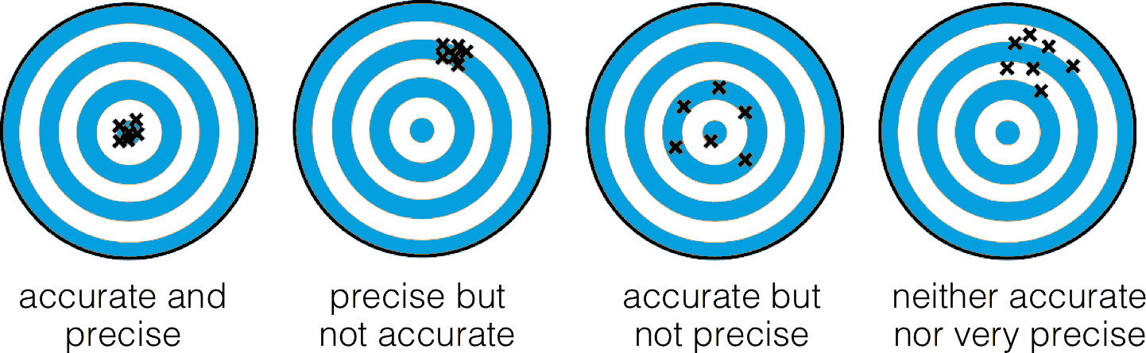
Data Soundness
Session 3
DATA SCIENCE ESSENTIALS

Slide 145
Common Error Sources
Session 3
When dealing with legacy, inherited or combined datasets (that is, datasets over which there is no collection and initial processing control):
missing data given a code
‘NA’/‘blank’ given a code
data entry error
coding error
measurement error
duplicate entries
heaping
DATA SCIENCE ESSENTIALS

Slide 146
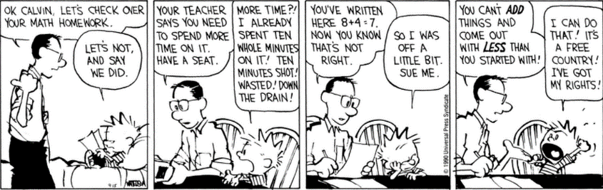
Session 3
[Bill Watterson, Calvin and Hobbes, 15 Sep. 1990]

Slide 147
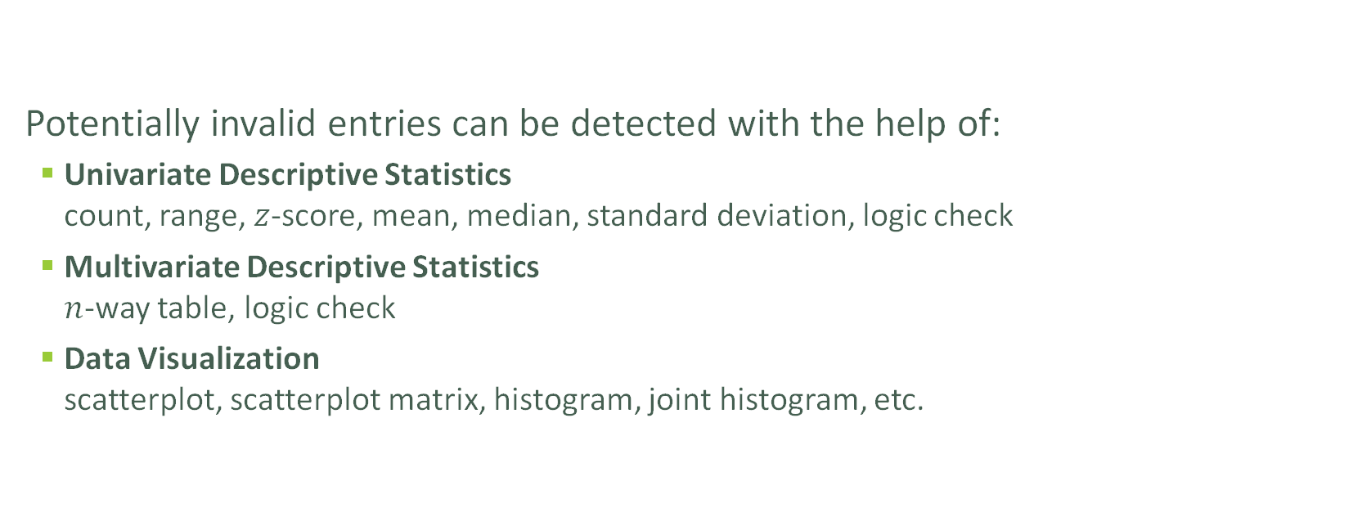
Detecting Invalid Entries
Session 3
Potentially invalid entries can be detected with the help of:
Univariate Descriptive Statistics count, range, $z$-score, mean, median, standard deviation, logic check
Multivariate Descriptive Statistics $n$-way table, logic check
Data Visualization scatterplot, scatterplot matrix, histogram, joint histogram, etc.
DATA SCIENCE ESSENTIALS

Slide 148
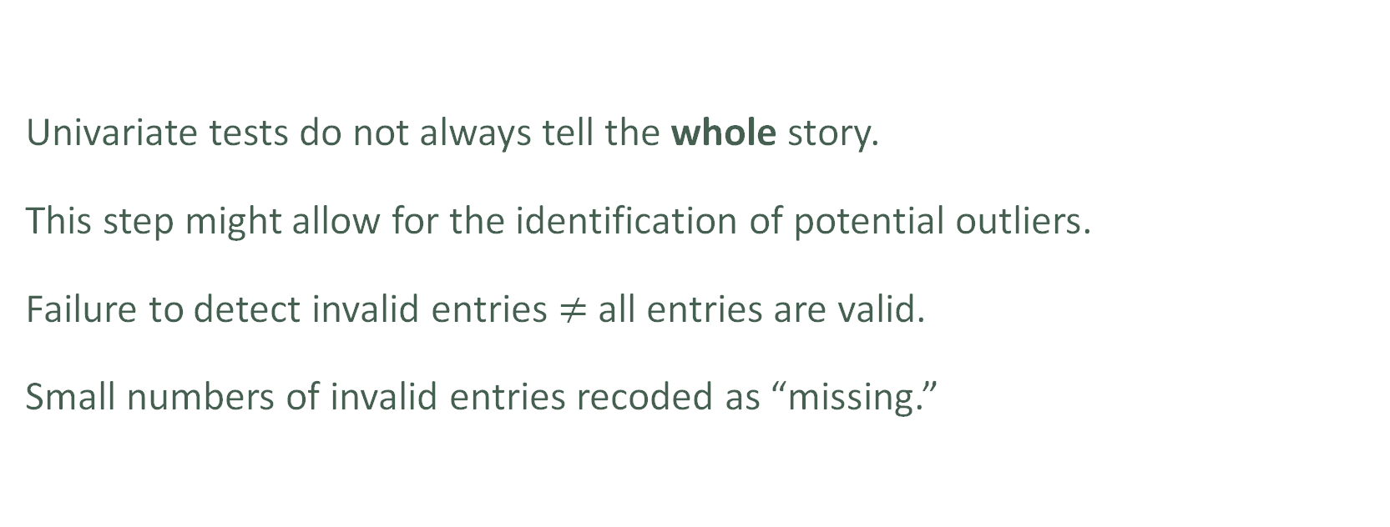
Detecting Invalid Entries
Session 3
Univariate tests do not always tell the whole story.
This step might allow for the identification of potential outliers.
Failure to detect invalid entries $≠$ all entries are valid.
Small numbers of invalid entries recoded as “missing.”
DATA SCIENCE ESSENTIALS

Slide 149
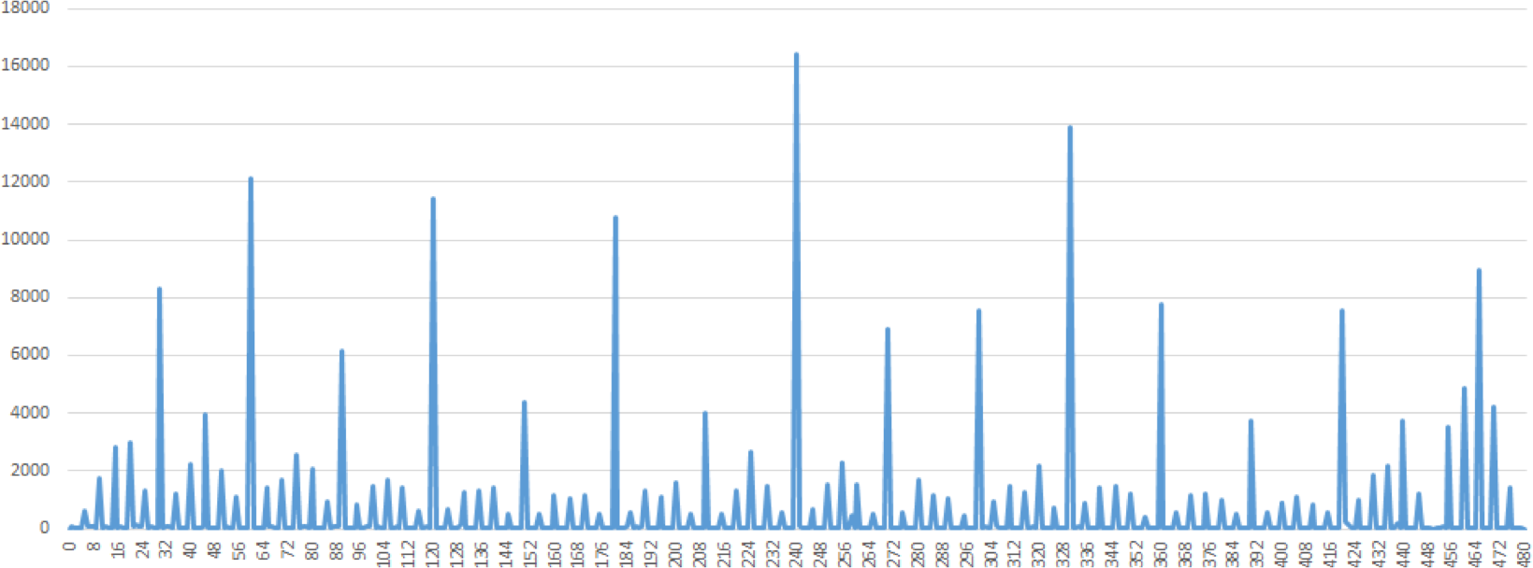
Detecting Invalid Entries
Session 3
DATA SCIENCE ESSENTIALS

Slide 150
Detecting Invalid Entries
Session 3
Time of arrivals at screening station, prior to departure (mins)
DATA SCIENCE ESSENTIALS

Slide 151
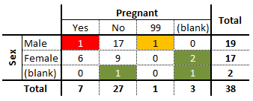
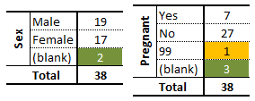
Detecting Invalid Entries
Session 3
vs.
DATA SCIENCE ESSENTIALS

Slide 152
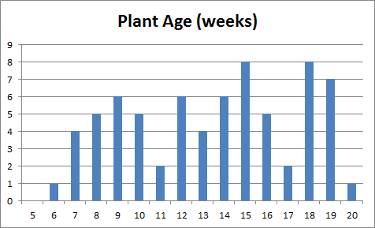
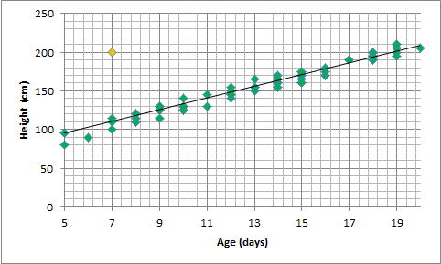
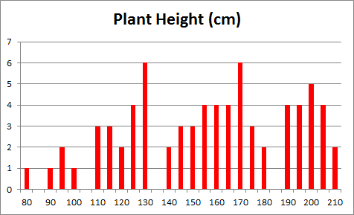
Detecting Invalid Entries
Session 3
vs.
DATA SCIENCE ESSENTIALS

Slide 153
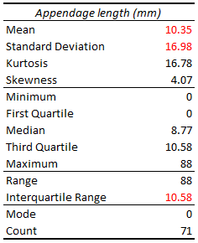
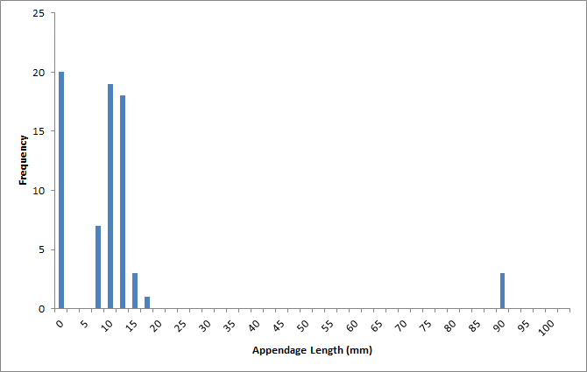
Detecting Invalid Entries
Session 3
DATA SCIENCE ESSENTIALS

Slide 154
Suggested Reading
Session 3
Data Understanding, Data Analysis, Data Science Data Preparation Introduction General Principles
Approaches to Data Cleaning
Pros and Cons
Tools and Methods
Data Quality
Common Error Sources
Detecting Invalid Entries
Data Quality
DATA SCIENCE ESSENTIALS

Slide 155
Exercises
Session 3
Recreate the examples of The Tidyverse.
Turn the dataset found in the file cities.txt into a tidy dataset.
Does the dataset found in the file cities.txt appear to be of good quality (is it sound? does it have invalid entries?)
Create a list of items that could be used in a methodical data cleaning checklist. Use data that you have encountered in the past as inspiration (numerical, categorical, text data).
Data Quality
DATA SCIENCE ESSENTIALS

Slide 156
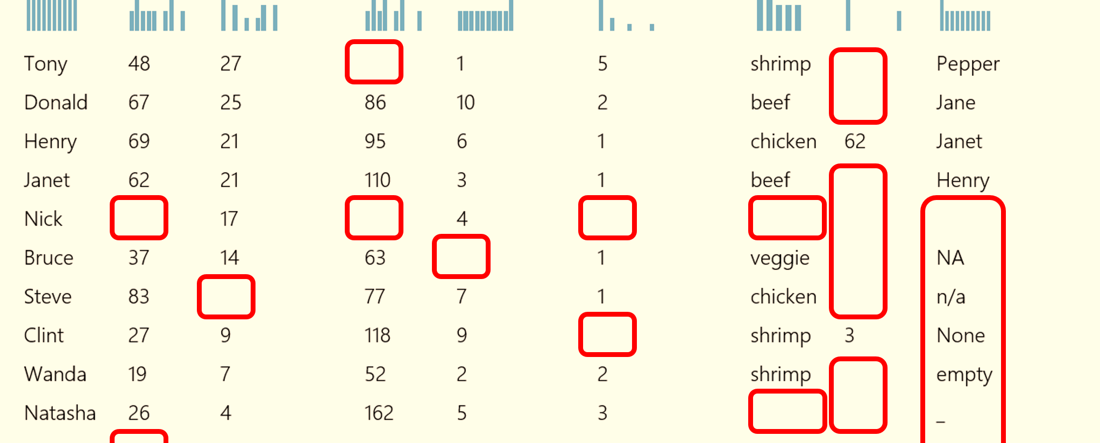
8. Missing Values
Session 3
DATA SCIENCE ESSENTIALS

Slide 157
Types of Missing Observations
Session 3
Blank fields come in 4 flavours:
nonresponse an observation was expected but none had been entered
data entry issue an observation was recorded but was not entered in the dataset
invalid entry an observation was recorded but was considered invalid and has been removed
expected blank a field has been left blank, but expectedly so
DATA SCIENCE ESSENTIALS

Slide 158
Types of Missing Observations
Session 3
Too many missing values (of the first three type) can be indicative of issues with the data collection process (more on this later).
Too many missing values (of the fourth type) can be indicative of poor questionnaire design.
Finding missing values can help you deal with other data science problems.
DATA SCIENCE ESSENTIALS

Slide 159
The Case for Imputation
Session 3
Not all analytical methods can easily accommodate missing observations:
discard the missing observation
not recommended, unless the data is MCAR in the dataset as a whole
acceptable in certain situations (e.g., small number of missing values in a large dataset)
come up with a replacement (imputation) value
main drawback: we never know what the true value would have been
often the best available option
DATA SCIENCE ESSENTIALS

Slide 160
Missing Values Mechanism
Session 3
Missing Completely at Random (MCAR)
item absence is independent of its value or of auxiliary variables
example: an electrical surge randomly deletes an observation in the dataset
Missing at Random (MAR)
item absence is not completely random; can be accounted by auxiliary variables with complete info
example: if women are less likely to tell you their age than men for societal reasons, but not because of the age values themselves)
DATA SCIENCE ESSENTIALS

Slide 161
Missing Values Mechanism
Session 3
Not Missing at Random (NMAR)
reason for nonresponse is related to item value (also called non-ignorable non-response)
example: if illicit drug users are less likely to admit to drug use than teetotallers
In general, the missing mechanism cannot be determined with any certainty; we may need to make assumptions (domain expertise can help).
DATA SCIENCE ESSENTIALS

Slide 162
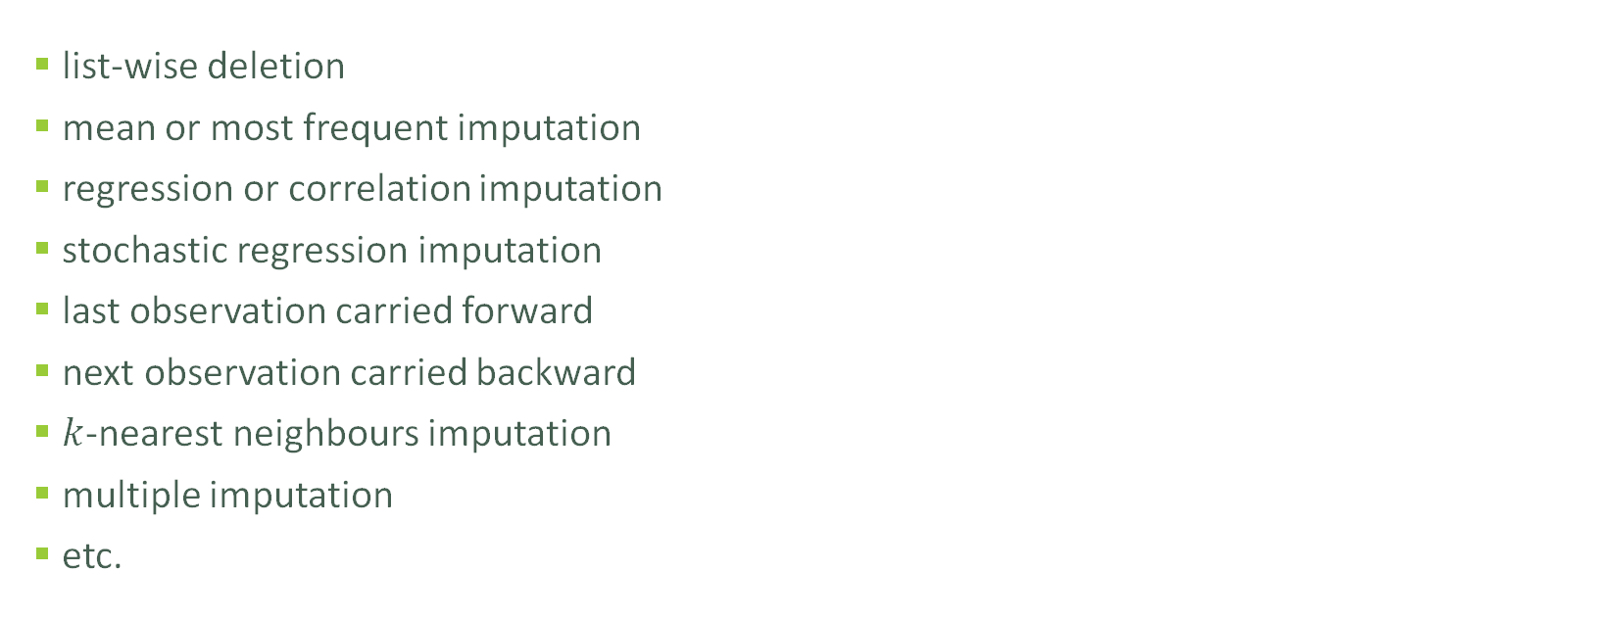
Imputation Methods
Session 3
list-wise deletion
mean or most frequent imputation
regression or correlation imputation
stochastic regression imputation
last observation carried forward
next observation carried backward
$k$-nearest neighbours imputation
multiple imputation
etc.
DATA SCIENCE ESSENTIALS

Slide 163
Imputation Methods
Session 3
List-wise deletion: remove units with at least one missing values
assumption: MCAR
cons: can introduce bias (if not MCAR), reduction in sample size, increase in standard error
Mean/most frequent imputation: substitute missing values by average/most frequent value
assumption: MCAR
cons: distortions of distribution (spike at mean) and relationships among variables
DATA SCIENCE ESSENTIALS

Slide 164
Imputation Methods
Session 3
Regression/correlation imputation: substitute missing values using fitted values based on other variables with complete information
assumption: MAR
cons: artificial reduction in variability, over-estimation of correlation
Stochastic regression imputation: regression/correlation imputation with a random error term added
assumption: MAR
cons: increased risk of type I error (false positives) due to small std error
DATA SCIENCE ESSENTIALS

Slide 165
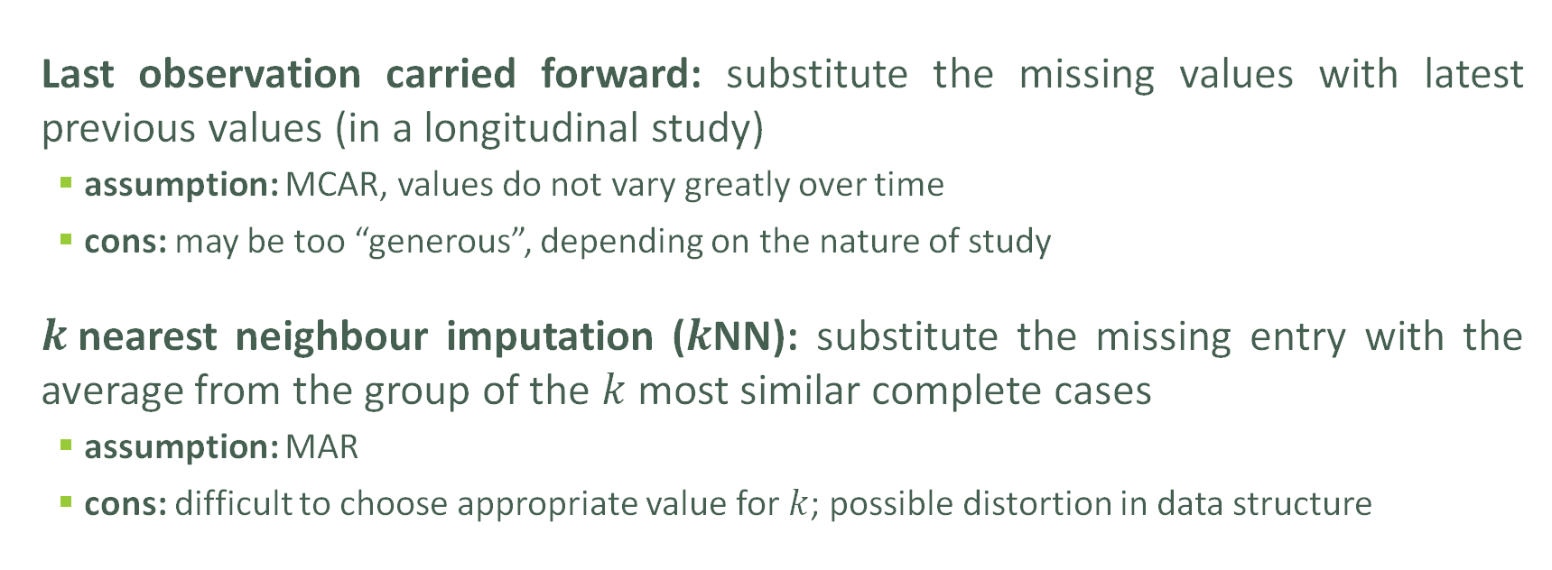
Imputation Methods
Session 3
Last observation carried forward: substitute the missing values with latest previous values (in a longitudinal study)
assumption: MCAR, values do not vary greatly over time
cons: may be too “generous”, depending on the nature of study
$k$nearest neighbour imputation ($k$NN): substitute the missing entry with the average from the group of the $k$ most similar complete cases
assumption: MAR
cons: difficult to choose appropriate value for $k$; possible distortion in data structure
DATA SCIENCE ESSENTIALS

Slide 166
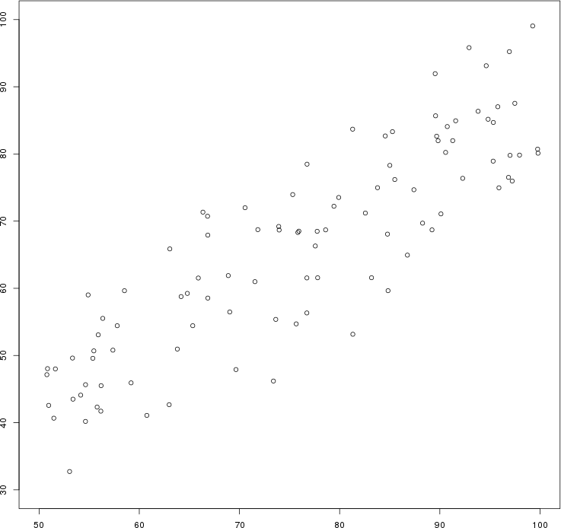
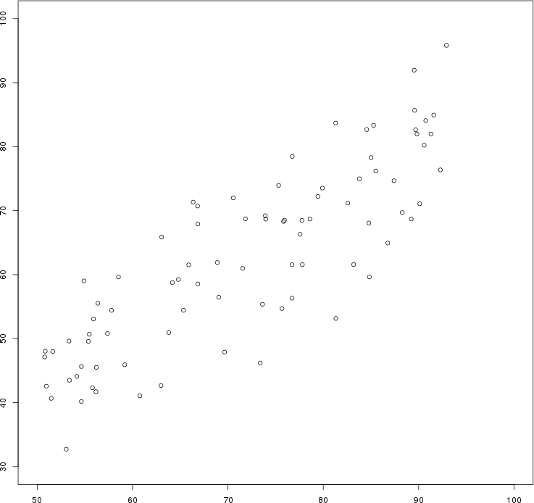
Session 3
Artificial data: the $y$ values of all points for which $x>92$ have been erased by mistake.
Original data
List-wise deletion

Slide 167
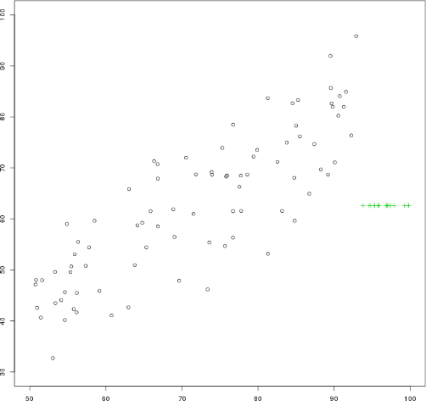
Session 3
Artificial data: the $y$ values of all points for which $x>92$ have been erased by mistake.
Original data
Mean imputation

Slide 168
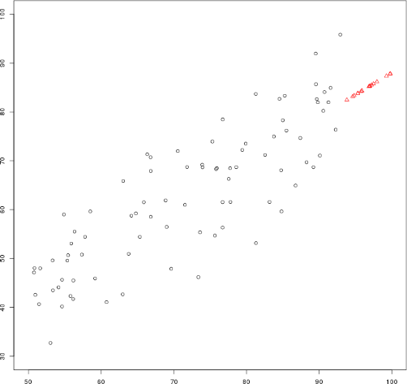
Session 3
Artificial data: the $y$ values of all points for which $x>92$ have been erased by mistake.
Original data
Regression imputation

Slide 169
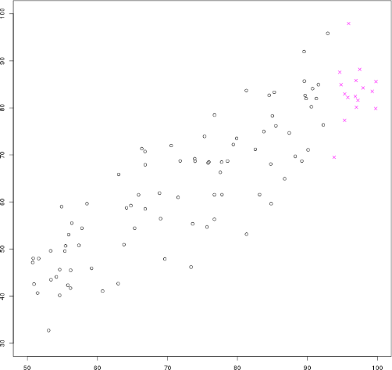
Session 3
Artificial data: the $y$ values of all points for which $x>92$ have been erased by mistake.
Original data
Stochastic regression imputation

Slide 170
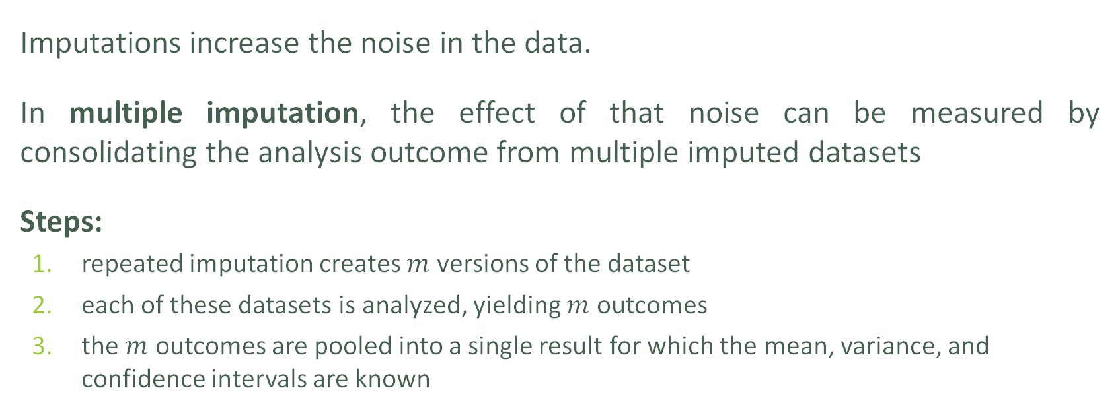
Multiple Imputation
Session 3
Imputations increase the noise in the data.
In multiple imputation, the effect of that noise can be measured by consolidating the analysis outcome from multiple imputed datasets
Steps:
repeated imputation creates $m$ versions of the dataset
each of these datasets is analyzed, yielding $m$ outcomes
the $m$ outcomes are pooled into a single result for which the mean, variance, and confidence intervals are known
DATA SCIENCE ESSENTIALS

Slide 171
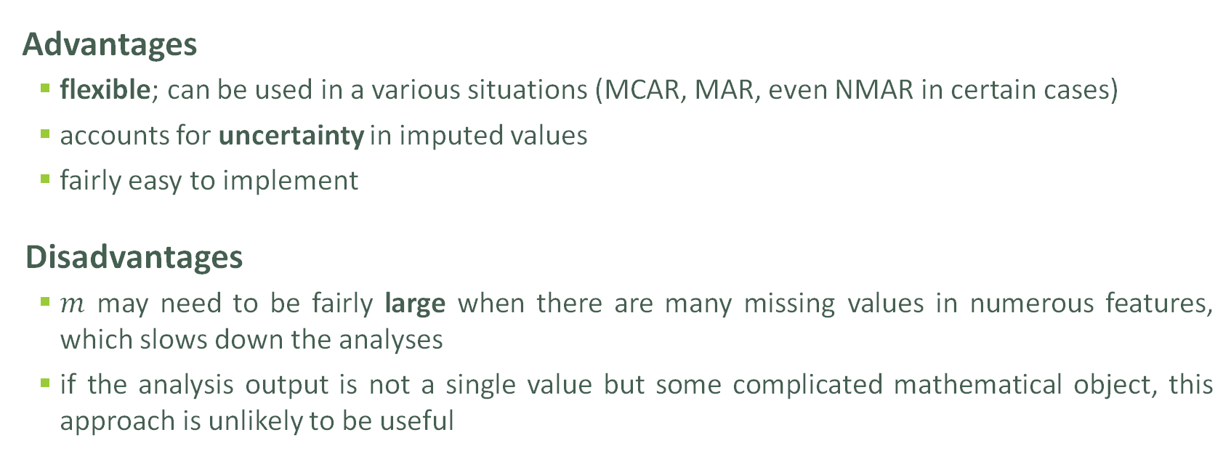
Multiple Imputation
Session 3
Advantages
flexible; can be used in a various situations (MCAR, MAR, even NMAR in certain cases)
accounts for uncertainty in imputed values
fairly easy to implement
Disadvantages
$m$ may need to be fairly large when there are many missing values in numerous features, which slows down the analyses
if the analysis output is not a single value but some complicated mathematical object, this approach is unlikely to be useful
DATA SCIENCE ESSENTIALS

Slide 172
Take-Aways
Session 3
Missing values cannot simply be ignored.
The missing mechanism cannot typically be determined with any certainty.
Imputation methods work best when values are MCAR or MAR, but imputation methods tend to produce biased estimates.
In single imputation, imputed data is treated as the actual data; multiple imputation can help reduce the noise.
Is stochastic imputation best? In our example, yes – but … No-Free Lunch theorem!
DATA SCIENCE ESSENTIALS

Slide 173
Suggested Reading
Session 3
Data Understanding, Data Analysis, Data Science Data Preparation Missing Values
Missing Value Mechanisms
Imputation Methods
Multiple Imputation
Missing Values
DATA SCIENCE ESSENTIALS

Slide 174
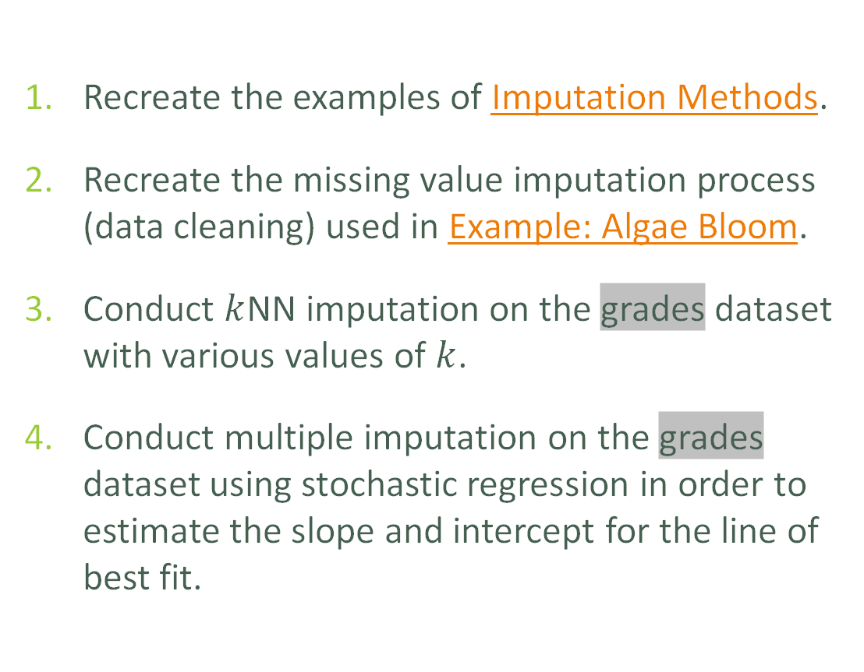
Exercises
Session 3
Recreate the examples of Imputation Methods.
Recreate the missing value imputation process (data cleaning) used in Example: Algae Bloom.
Conduct $k$NN imputation on the grades dataset with various values of $k$.
Conduct multiple imputation on the grades dataset using stochastic regression in order to estimate the slope and intercept for the line of best fit.
Missing Values
DATA SCIENCE ESSENTIALS

Slide 175

9. Anomalous Observations
Session 3
DATA SCIENCE ESSENTIALS

Slide 176
Anomalous Observations
Session 3
In practice, an anomalous observation may arise as
a “bad” object/measurement: data artifacts, spelling mistakes, poorly imputed values, etc.
a misclassified observation: according to the existing data patterns, the observation should have been labeled differently;
an observation whose measurements are found in the distribution tails of a large enough number of features;
an unknown unknown: a completely new type of observations whose existence was heretofore unsuspected.
DATA SCIENCE ESSENTIALS
176

Slide 177
Anomalous Observations
Session 3
Observations could be anomalous in one context, but not in another:
A 6-foot tall adult male is in the 86th percentile for Canadian males (tall, but not unusual)
in Bolivia, the same man would be in the 99.9th percentile (very tall and unusual)
Anomaly detection points towards interesting questions for analysts and subject matter experts: in this case, why is there such a large discrepancy in the two populations?
DATA SCIENCE ESSENTIALS
177

Slide 178
Outliers
Session 3
Outlying observations are data points which are atypical in comparison to
the unit's remaining features (within-unit),
the field measurements for other units (between-units)
Outliers are observations which are dissimilar to other cases or which contradict known dependencies or rules.
Careful study is needed to determine whether outliers should be retained or removed from the dataset.
DATA SCIENCE ESSENTIALS

Slide 179
Detecting Anomalies
Session 3
Outliers may be anomalous along any of the unit’s variables, or in combination.
Anomalies are by definition infrequent, and typically shrouded in uncertainty due to small sample sizes.
Differentiating anomalies from noise or data entry errors is hard.
Boundaries between normal and deviating units may be fuzzy.
Anomalies associated with malicious activities are typically disguised.
DATA SCIENCE ESSENTIALS

Slide 180
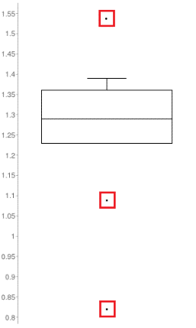
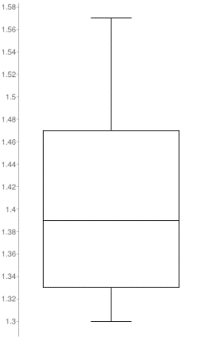
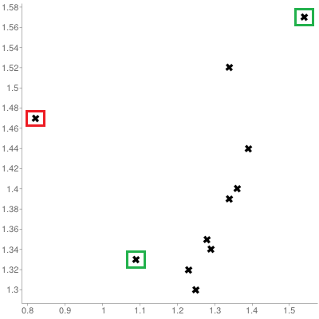
Visual Outlier Detection
Session 3
Queuing dataset: processing rate vs. arrival rate
DATA SCIENCE ESSENTIALS

Slide 181
Detecting Anomalies
Session 3
Numerous methods exist to identify anomalous observations; none of them are foolproof and judgement must be used.
Graphical methods are easy to implement and interpret:
Outlying Observations
box-plots, scatterplots, scatterplot matrices, 2D tour, Cooke's distance, normal qq plots
Influential Data
some level of analysis must be performed (leverage)
Careful: once anomalous observations have been removed from the dataset, previously “regular" units may become anomalous.
DATA SCIENCE ESSENTIALS

Slide 182
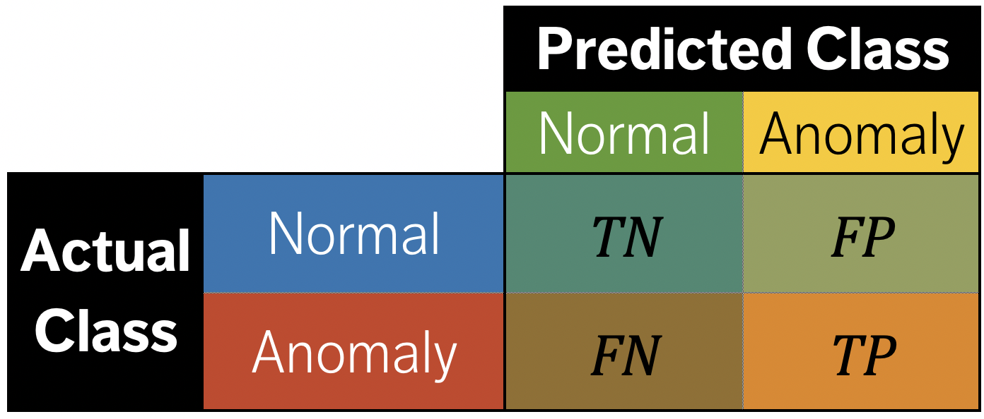
Anomaly Detection Algorithms
Session 3
Supervised methods use a historical record of labeled anomalous observations:
domain expertise is required to tag the data
classification or regression task
rare occurrence problem
Unsupervised methods don’t use external information:
traditional methods and tests
can also be seen as a clustering or association rules problem
DATA SCIENCE ESSENTIALS

Slide 183

Anomaly Detection Algorithms
Session 3
The mis-classification cost is often assumed to be symmetrical, which can lead to technically correct but useless outputs.
For instance, most (99.999+%) air passengers do not bring weapons with them on flights; a model that predicts that no passenger is smuggling a weapon would be 99.999+% accurate, but it would miss the point completely.
For the security agency, the cost of wrongly thinking that a passenger is:
smuggling a weapon $⟹$ cost of a single search
NOT smuggling a weapon $⟹$catastrophe (potentially)
The wrongly targeted individuals may have a different take on this!
DATA SCIENCE ESSENTIALS

Slide 184

Anomaly Detection Algorithms
Session 3
If all participants in a workshop except for one can view the video conference lectures, then the one individual/internet connection/computer is anomalous – it behaves in a manner which is different from the others.
But this DOES NOT MEAN that the different behaviour is necessarily the one we are interested in…
DATA SCIENCE ESSENTIALS

Slide 185


Simple Outlier Tests
Session 3
Tukey’s Boxplot test: for normally distributed data, regular observations typically lie between the inner fences
$Q_{1}−1.5×\left(Q_{3}−Q_{1}\right)$ and $Q_{3}+1.5×\left(Q_{3}−Q_{1}\right)$.
Suspected outliers lie between the inner fences and the outer fences
$Q_{1}−3×\left(Q_{3}−Q_{1}\right)$ and $Q_{3}+3×\left(Q_{3}−Q_{1}\right)$.
Outliers lie beyond the outer fences.
outliers
outer fence
suspected
outliers
inner fence
regular
points
DATA SCIENCE ESSENTIALS

Slide 186
Simple Outlier Tests
Session 3
The Dixon Q Test is used in experimental sciences to find outliers in (extremely) small datasets (dubious validity).
The Mahalanobis Distance (linked to the leverage) can be used to find multi-dimensional outliers (when relationships are linear).
Other simple tests:
Grubbs (univariate)
Tietjen-Moore (for a specific # of outliers)
generalized extreme studentized deviate (for unknown # of outliers)
chi-square (outliers affecting goodness-of-fit)
DATA SCIENCE ESSENTIALS

Slide 187
Sophisticated Anomaly Detection
Session 3
DBSCAN, OR_{h}, and LOF (unsupervised outlier detection)
rank-power method (supervised outlier detection)
distance or density-based methods (with exotic distance measures)
autoencoders and reconstruction error (deep learning method)
rare-occurrence methods (oversampling, undersampling, CREDOS, PN, SHRINK, SMOTE, DRAMOTE, SMOTEBoost, RareBoost, MetaCost, AdaCost, CSB, SSTBoost, etc.)
AVF, Greedy algorithms (categorical data)
PCA, DOBIN, and other projection methods (for high-dimensional data)
subspace methods and ensemble methods
DATA SCIENCE ESSENTIALS

Slide 188
Influential Observations
Session 3
Influential data points are observations whose absence leads to markedly different analysis results.
When influential observations are identified, remedial measures (such as data transformations) may be required to minimize their undue effects.
Outliers may be influential data points; influential data points need not be outliers (and vice-versa).
DATA SCIENCE ESSENTIALS

Slide 189



Influential Observations
Session 3
Queuing dataset: processing rate vs. arrival rate
DATA SCIENCE ESSENTIALS

Slide 190
Anomaly Detection Remarks
Session 3
Identifying influential points is an iterative process as the various analyses have to be run numerous times.
Fully automated identification and removal of anomalous observations is NOT recommended.
Use data transformations if the data is NOT normally distributed.
Whether an observation is an outlier or not depends on various factors; what observations end up being influential data points depends on the specific analysis to be performed.
DATA SCIENCE ESSENTIALS

Slide 191
Suggested Reading
Session 3
Data Understanding, Data Analysis, Data Science Data Preparation
Anomalous Observations
Anomaly Detection
Outlier Tests
Visual Outlier Detection
*Anomaly Detection and Outlier Analysis (advanced)
Anomalous Observations
DATA SCIENCE ESSENTIALS

Slide 192
Exercises
Session 3
Recreate the anomaly detection process used in Example: Algae Bloom.
Find anomalous observations in the cities.txt and grades datasets (if applicable).
Find anomalous observations in a dataset of your choice.
Anomalous Observations
DATA SCIENCE ESSENTIALS

Slide 193
Session 4
DATA SCIENCE ESSENTIALS

Slide 194

10. Dimensionality and Data Transformations
Session 4
DATA SCIENCE ESSENTIALS

Slide 195
Dimensionality of Data
Session 4
In data analysis, the dimension of the data is the number of attributes that are collected in a dataset, represented by the number of columns.
We can think of the number of variables used to describe each object (row) as a vector describing that object: the dimension is simply the size of that vector.
(Note: “dimension” is used differently in business intelligence contexts)
DATA SCIENCE ESSENTIALS

Slide 196

High Dimensionality and Big Data
Session 4
Datasets can be “big” in a variety of ways:
too large for the hardware to handle (cannot be stored, accessed, manipulated properly due to # of observations, # of features, the overall size)
dimensions can go against modeling assumptions (# of features $≫$ # observations)
Examples:
Multiple sensors recording 100+ observations per second in a large geographical area over a long time period = very big dataset
In a corpus’ Term Document Matrix (cols = terms, rows = documents), the number of terms is usually substantially higher than the number of documents, leading to sparse data
DATA SCIENCE ESSENTIALS

Slide 197


Curse of Dimensionality
Session 4
[http://simplystatistics.org]
42% of data is captured
14% of data is captured
7% of data is captured
$N=100$observations, uniformly distributed on ${[0,1]}^{d}, d=1, 2, 3$.
% of observations captured by ${[0,1/2]}^{d},d=1,2,3$.
DATA SCIENCE ESSENTIALS

Slide 198
Sampling Observations
Session 4
Question: does every row of the dataset need to be used?
If rows are selected randomly (with or without replacement), the resulting sample might be representative of the entire dataset.
Drawbacks:
if the signal of interest is rare, sampling might drown it altogether
if aggregation is happening down the road, sampling will necessarily affect the numbers (passengers vs. flights)
even simple operations on a large file (finding the # of lines, say) can be taxing on the memory – prior information on the dataset structure can help
DATA SCIENCE ESSENTIALS

Slide 199

Feature Selection
Session 4
Removing irrelevant/redundant variables is a common data processing task.
Motivations:
modeling tools do not handle these well (variance inflation due to multicolinearity, etc.)
dimension reduction (# variables $≫$ # observations)
Approaches:
filter vs. wrapper
unsupervised vs. supervised
DATA SCIENCE ESSENTIALS

Slide 200

Dimension Reduction: PCA
Session 4
[A. Ng, K. Soo, Numsense!]
Motivational Example: Nutritional Content of Food
What is the best way to differentiate food items? Vitamin content, fat, or protein level? A bit of each?
Principal Component Analysis (PCA) can be used to find the combinations of variables along which the data points are most spread out (dimension reduction).
DATA SCIENCE ESSENTIALS

Slide 201


Dimension Reduction: PCA
Session 4
[A. Ng, K. Soo, Numsense!]
Presence of nutrients appears to be correlated among food items.
In the (small) sample consisting of Lamb, Pork, Kale, and Parsley, Fat and Protein levels seem in step, as do Fiber and Vitamin C.
In a larger dataset, the correlations are $r=0.56$ and $r=0.57$.
How much could 2 derived variables explain?
DATA SCIENCE ESSENTIALS

Slide 202




PCA Differentiation
Session 4
$${\text{PC}}_{1}= −0.45×\text{Fat} −0.55×\text{Protein} +0.55×\text{Fiber} +0.44×\text{Vitamin} \text{C}$$
$${\text{PC}}_{2}= 0.66×\text{Fat}+0.21×\text{Protein} +0.19×\text{Fiber} +0.70×\text{Vitamin} \text{C}$$
$${\text{PC}}_{2}$$
${\text{PC}}_{1}$differentiates vegetables from meats; ${\text{PC}}_{2}$ differentiates 2 sub-categories within these:
meats are concentrated on the left (low ${\text{PC}}_{1}$ values)
vegetables are concentrated on the right (high ${\text{PC}}_{1}$ values)
seafood have lower Fat content (low ${\text{PC}}_{2}$ values) and are concentrated at the bottom
non-leafy veggies have lower Vitamin C content (low ${\text{PC}}_{2}$ values) and are also bunched at the bottom
$${\text{PC}}_{1}$$
DATA SCIENCE ESSENTIALS

Slide 203
Common Transformations
Session 4
Models sometimes require that certain data assumptions be met (normality of residuals, linearity, etc.).
If the raw data does not meet the requirements, we can either:
abandon the model
attempt to transform the data
The second approach requires an inverse transformation to be able to draw conclusions about the original data.
DATA SCIENCE ESSENTIALS

Slide 204

Common Transformations
Session 4
In the data analysis context, transformations are monotonic:
logarithmic
square root, inverse, power: $W^{k}$
exponential
Box-Cox, etc.
Transformations on $X$ may achieve linearity, but usually at some price (correlations are not preserved, for instance). Transformations on $Y$ can help with non-normality and unequal variance of error terms.
DATA SCIENCE ESSENTIALS

Slide 205







Session 4
Original Data
Square $(Y^{2})$
Square Root $(\sqrt{Y})$
Reciprocal $(1/Y)$

Slide 206


Box-Cox Transformation
Session 4
$gm$ = geometric mean
Assume the usual model $Y_{j}=\sum_{i}{β_{i}X_{j,i}}+ε_{j}$ with either
skewed residuals
not-constant variance
non-linear trend
The Box-Cox transformation $Y_{j}↦Y_{j}′(λ)$ suggests a choice: select $λ$which maximizes the corresponding log-likelihood
$Y_{j}′(λ)=\left\{\begin{matrix}\text{g}\text{m}\left(Y\right)×ln⁡(Y_{j}), λ=0 \\ λ^{−1}{\text{g}\text{m}\left(Y\right)}^{1−λ}×({Y_{j}}^{λ}−1), λ≠0\end{matrix}\right.$
DATA SCIENCE ESSENTIALS

Slide 207

Box-Cox Transformation
Session 4
The procedure provides a guide to select a transformation.
Theoretical/practical rationales may exist for a particular choice of $λ$.
Residual analysis is still required to ensure that the choice was appropriate.
Better to work with (interpret) the transformed data.
DATA SCIENCE ESSENTIALS

Slide 208


Session 4
Logarithm (Box-Cox, $λ=0$)

Slide 209

Scaling
Session 4
Numeric variables may have different scales (i.e., weights and heights).
The variance of a large-range variable is typically greater than that of a small-range variable, introducing a bias (for instance).
Standardization creates a variable with mean $0$ and std. dev. $1$:
$Y_{i}=\frac{X_{i}−\overline{X}}{s_{X}}$
Normalization creates a new variable in the range $\left[0,1\right]$: $Y_{i}=\frac{X_{i}−\min{X}}{\max{X−\min{X}}}$
DATA SCIENCE ESSENTIALS

Slide 210
Discretizing
Session 4
To reduce computational complexity, a numeric variable may need to be replaced by an ordinal variable (from height value to “short”, “average”, “tall”, for instance).
Domain expertise can be used to determine the bins’ limits (although that may introduce unconscious bias to the analyses)
In the absence of such expertise, limits can be set so that either
the bins each contain the same number of observations
the bins each have the same width
the performance of some modeling tool is maximized
DATA SCIENCE ESSENTIALS

Slide 211

Creating Variables
Session 4
New variables may need to be introduced:
as functional relationships of some subset of available features
because modeling tool may require independence of observations
because modeling tool may require independence of features
to simplify the analysis by looking at aggregated summaries (often used in text analysis)
Time dependencies $⟶$ time series analysis (lags?)
Spatial dependencies $⟶$ spatial analysis (neighbours?)
DATA SCIENCE ESSENTIALS

Slide 212
Suggested Reading
Session 4
Data Understanding, Data Analysis, Data Science Data Preparation
Data Transformations
Common Transformations
Box-Cox Transformations
Scaling
Discretizing
Creating Variables
*Feature Selection and Dimension Reduction (advanced)
Dimensionality and Data Transformations
DATA SCIENCE ESSENTIALS

Slide 213
Exercises
Session 4
Using Example: Algae Bloom as a basis, scale, discretize, and create new variables out of the algae blooms dataset.
Scale, discretize, and create new variables out of the grades and cities.txt datasets.
Scale, discretize, and create new variables out of a dataset of your choice.
Dimensionality and Data Transformations
DATA SCIENCE ESSENTIALS

Slide 214
Miscellanea
Session 4
DATA SCIENCE ESSENTIALS

Slide 215

11. Data Engineering
Session 4
DATA SCIENCE ESSENTIALS

Slide 216
Background
Session 4
One of the data science challenge: putting large troves of data into formats that can be read by algorithms.
Data engineering is related to processing an ever-increasing supply of data.
After processing, data scientists develop proofs-of-concept; AI/ML engineers translate these into deployable models.
Data/ML engineering have been around a while (software logs); with the rise of cloud computing, some argue that expertise in these fields is becoming more sought after than expertise in data analysis (at least, in some circles).
DATA SCIENCE ESSENTIALS

Slide 217
Data Roles (Reprise)
Session 4
Data Engineers
receive data from a source
structure, distribute, and store data into data lakes and warehouses
create tools and data models which data scientists can use to query the data
ML Engineers
apply and deploy data models
bridge gaps between data engineers and data scientists
take proof-of-concept ideas to large scale
Data Scientists
receive data procured/provided by DE
extract value from the data
build proof-of-concept predictive models
measure and improve results
build analytical models
DATA SCIENCE ESSENTIALS

Slide 218

Data Roles
Session 4
In smaller organizations, data engineering and data science are typically blended into the same role.
Larger companies have dedicated data engineers on staff, who build data pipelines and manage data warehouses (populating them with data and creating table schemas to keep track of the stored data).
In general, DE $≠$ DS.
DATA SCIENCE ESSENTIALS

Slide 219
Data Pipelines
Session 4
Data engineering
operations that create interfaces and mechanisms for the flow and access of information
setting up data infrastructure, preparing it for further analysis by data scientists
Data can arise from many sources (and types of sources), and in a variety of formats and size.
Transforming this into a process that data scientists can use and from which they can derive meaning is known as building a data pipeline.
DATA SCIENCE ESSENTIALS

Slide 220

Data Pipelines
Session 4
9 components 5 stages + 4 transitions
DATA SCIENCE ESSENTIALS

Slide 221
Data Pipelines
Session 4
Main data engineering challenge:
building a pipeline that runs in (close to) real-time whenever it is requested
so that users get up-to-date information from the source with minimal delays
Working pipeline proof-of-concept solutions are passed on to ML engineers for deployment and production. Some of the work surrounding this includes:
data quality checks
optimizing query performance
creating a continuous integration/continuous delivery ecosystem around model changes
ingesting data from various sources into the data model
carrying machine learning and data science techniques to distributed systems.
DATA SCIENCE ESSENTIALS

Slide 222
Data Pipelines
Session 4
Common themes (operations/framework/tasks/sources) for pipeline steps :
data collection: applications, mobile apps, microservices, Internet of Things (IoT) devices, websites, instrumentation, logging, sensors, external data, user generated content, etc.
data storage: Master Data Management (MDM), warehouse, data lake, etc.
data integration/preparation: ETL, stream data integration, etc.
data analysis: machine learning, predictive analytics, A/B testing, experiments, artificial intelligence (AI), deep learning, etc.
delivery and presentations: dashboards, reports, microservices, push notifications, email, SMS, etc.
DATA SCIENCE ESSENTIALS

Slide 223









Data Collection
Session 4
Surveys
Observations
User Feedback
Documents
Online Tracking
Social Media
Interviews
Web Services
DATA SCIENCE ESSENTIALS

Slide 224






ETL – Extract
Session 4
Extract
Transform
Load
DATA SCIENCE ESSENTIALS

Slide 225






ETL – Transform
Session 4
Changing Structure
Altering Data Types
Aggregating Data
Cleaning
Joining
Grouping
Extract
Transform
Load
DATA SCIENCE ESSENTIALS

Slide 226






ETL – Load
Session 4
Dataset
Data
Warehouse
Extract
Transform
Load
DATA SCIENCE ESSENTIALS

Slide 227

Data Pipeline: Open Source
Session 4
DATA SCIENCE ESSENTIALS
227

Slide 228

Data Pipeline: GoC (?)
Session 4
DATA SCIENCE ESSENTIALS
228

Slide 229
Data Pipeline Tools
Session 4
Pipelines let users split large tasks into a series of smaller sequential steps, which can help optimize each step.
If using TensorFlow for the analysis component of a DL pipeline which consists of a single large script, then everything from data collection to presentation has to be done with TensorFlow; may not be optimal.
Data pipeline tools select the best framework/language for each pipeline component/task:
Luigi (Spotify)
Airflow (AirBnB)
scikit-learn
pandas/tidyverse
etc.
DATA SCIENCE ESSENTIALS

Slide 230
Data Engineering Tools
Session 4
It is unlikely that one data engineer could achieve mastery over all possible data engineering tools, but teams might get a lot of coverage:
analytical databases (Big Query, Redshift, Synapse, etc.)
ETL (Spark, Databricks, DataFlow, DataPrep, etc.)
scalable compute engines (GKE, AKS, EC2, DataProc, etc.)
process orchestration (AirFlow/Cloud Composer, Bat, Azure Data Factory, etc.)
platform deployment and scaling (Terraform, custom tools, etc.)
visualization tools (Power BI, Tableau, Google Data Studio, D3.js, ggplot2, etc.)
programming (tidyverse, numpy, pandas, matplotlib, scikit-learn, scipy, Spark, Scala, Java, SQL, T-SQL, H-SQL, PL/SQL, etc.)
DATA SCIENCE ESSENTIALS

Slide 231

What is Data Governance?
Session 4
Data governance encompasses:
people
processes
information technology
It is required to create a consistent and proper handling of an organization's data across the enterprise.
It provides the foundation, strategy, and structure to ensure that data is managed as an asset and transformed into meaningful information.
DATA SCIENCE ESSENTIALS

Slide 232
Data Governance
Session 4
Data Governance
Data Architecture
Data Modeling & Design
Data Storage & Operations
Data Security
Data Integration & Interoperability
Document & Content Management
Reference & Master Data
Data Warehousing & BI
Metadata
Data Quality
Goals:
create self-service data culture
establish internal rules for data use
implement compliance requirements
improve internal and external comms
increase value of data
reduce costs
continually manage risks
ensure continued existence
DATA SCIENCE ESSENTIALS

Slide 233
Suggested Reading
Session 4
Data Understanding, Data Analysis, Data Science Data Engineering and Management
Background and Context
Data Engineering
Data Pipelines
Automatic Deployment and Operations
Scheduled Pipelines and Workflows
Data Engineering Tools
Data Engineering
DATA SCIENCE ESSENTIALS

Slide 234
Exercises
Session 4
What does your (or your organization’s) data science pipeline look like? Could it be improved?
Identify instances where you have had issues due to data availability, usability, consistency, integrity, quality, security, or trustworthiness.
Complete any of the previous exercises you have not had the chance to finish.
Data Engineering
DATA SCIENCE ESSENTIALS

Slide 235

12. Data Management
Session 4
DATA SCIENCE ESSENTIALS

Slide 236
Fundamental Concepts
Session 4
Data and knowledge must be structured so that it can be:
stored and accessible
added to
usefully and efficiently extracted from that store (extract – transform – load)
operated over by humans and computers (programs, bots, A.I.)
DATA SCIENCE ESSENTIALS

Slide 237

Data Modeling
Session 4
Data models are abstract/logical descriptions of a system, using terms that are implementable as the structure of a type of data management software.
This is half-way between a conceptual model and a database implementation.
The data itself is about instances – the model is about the object types.
Another option to consider: ontologies.
DATA SCIENCE ESSENTIALS

Slide 238

Automated Data Pipeline
Session 4
Data Model
Do they match? Each other? The conceptual model?
Data
Collection
Data
Storage
Mathematical Model
Statistical Model
Programmatic Model
Data
Preparation
Data
Analysis
Data
Presentation
DATA SCIENCE ESSENTIALS

Slide 239

Contextual Metadata
Session 4
[Representation of Langerhans cells in the Cell Ontology, A. M. Masci et al.]
Something gets lost when we move from conceptual models to either a data or a knowledge model.
One way of keeping the context is to provide rich metadata – data about the data.
Metadata is crucial when it comes to carrying out strategies for working across datasets.
Ontologies can also play a role here.
DATA SCIENCE ESSENTIALS

Slide 240

Structured/Unstructured Data
Session 4
A major motivator for new developments in database types and other data storing strategies is the increasing availability of unstructured data and 'blob' data:
structured data: labeled, organized, discrete structure is constrained and pre-defined
unstructured data: not organized, no specific pre-defined structure data model (text)
blob data: Binary Large Object (blob) – images, audio, multi-media
DATA SCIENCE ESSENTIALS

Slide 241

Data Modeling
Session 4
Different options are currently popular in terms of fundamental data and knowledge modeling or structuring strategies:
key-value pairs (e.g., JSON)
triples (e.g., RDF)
graph databases
relational databases
spreadsheets
DATA SCIENCE ESSENTIALS

Slide 242
Stores and Databases
Session 4
Relational Database:
widely supported, well understood, works well for many types of systems and use cases, difficult to change once implemented, doesn't deal with relationships well
Key-Value Stores:
can take any sort of data, no need to know much about its structure in advance, missing values don’t take up space, can get messy, difficult to find specific data
Graph Databases:
fast and intuitive for heavily relation-based data, might be the only option in this case as traditional databases may slow to a crawl, probably overkill in other cases, not yet widely supported
DATA SCIENCE ESSENTIALS

Slide 243
Flat Files and Spreadsheets
Session 4
Pros:
very efficient if collecting data only once, about one particular type of object
some types of analysis require all the data in one place
easy to read into analysis software and do operations over the entire dataset
Cons:
very hard to manage data integrity if continually collecting data
not ideal for system data involving multiples types of objects and relationships
can be very difficult to carry out data querying operations
DATA SCIENCE ESSENTIALS

Slide 244
Tools and Buzzwords
Session 4
MongoDB, ArangoDB
Document store
JSON, YAML
API, GraphQL
Linked Data
Semantic Web
Ontology Web Language (OWL)
Protégé
SQL, etc.
DATA SCIENCE ESSENTIALS

Slide 245
Data Model Implementation
Session 4
To implement your data/knowledge model, one needs access to data storage and management software.
This can be a challenge for individuals: such software usually runs on servers.
Servers are good because they allows multiple users to access a single database simultaneously, from different client programs, but it makes it difficult to “play” with the data.
This is where SQLite comes into play.
DATA SCIENCE ESSENTIALS

Slide 246
Data Management Software
Session 4
Data management software provides users with an easy way to interact with their data.
It’s essentially a human – data interface.
Through this interface, users can:
add data to their data collection
extract subsets of data from their collection based on certain criteria
delete or edit data in their collection
DATA SCIENCE ESSENTIALS

Slide 247
Names / Terminology
Session 4
Previously:
database
data warehouse
data marts
database management system
(SQL)
Now:
data lake
data pool
data swamp?
data graveyard?
(NoSQL)
Increasingly: distinction between data store and data management software.
DATA SCIENCE ESSENTIALS

Slide 248
From Data Model to Implementation
Session 4
Once the (logical) data mode is completed
instantiate the model in chosen software (e.g., create tables in MySQL)
load the data
query the data:
traditional relational databases use Structured Query Language (SQL)
others use different query languages (AQL, semantic engines, etc.) or rely on bespoke computer programs (e.g., written in R, Python)
DATA SCIENCE ESSENTIALS

Slide 249
Database Management
Session 4
Once data has been collected, it must also be managed.
Fundamentally, this means that the database must be maintained, so that the data is
accurate,
precise,
consistent
complete
Don’t let your data lake turn into a data swamp!
DATA SCIENCE ESSENTIALS

Slide 250

Cloud Service Provider
Session 4
Store large amounts of data
Run expensive and advanced processes with click of a button
Flexible and scalable
Enable low-code data wrangling
DATA SCIENCE ESSENTIALS

Slide 251


Cloud vs. On-Premise
Session 4
Cloud
On-Premise (On-Prem)
hands-off
self-maintained
pay-as-you-go model
all costs absorbed
questionable data ownership
fully-controlled security
DATA SCIENCE ESSENTIALS

Slide 252
Suggested Reading
Session 4
Data Understanding, Data Analysis, Data Science Data Science Basics
Getting Insight From Data
Structuring and Organizing Data
Data Engineering and Management
Data Management
Databases
Data Modeling
Data Storage
Reporting and Deployment
Reports and Products
Cloud and On-Premise Architecture
Data Management
DATA SCIENCE ESSENTIALS

Slide 253
Exercises
Session 4
Does your organization have data? If so, is it hosted on-premise or on the cloud? How is it accessed? Structured?
Complete any of the previous exercises you have not had the chance to finish.
Data Management
DATA SCIENCE ESSENTIALS

Slide 254
Suggested Exercises and Guided Projects
DATA SCIENCE ESSENTIALS

Slide 255
Between Sessions
Session 1 to Session 2
complete the exercises of session 1
download the datasets from the website
read Programming Primer (sections 1 – 4)
install R / RStudio (Posit)
install the following R packages: dplyr, xts, knitr, tidyverse, ggplot2, pastecs, Hmisc, e1071, psych, quantmod, ggm, kerndwd, MASS, DMwR, ROCR, car, forcats, corrplot
Session 2 to Session 3
complete the exercises of session 2
Session 3 to Session 4
complete the exercises of session 3
After Session 4
complete the exercises of session 4
attempt the guided projects
DATA SCIENCE ESSENTIALS

Slide 256
Guided Project I
Select a data project of interest (personally or professionally) and provide a planning draft for it, touching on the topics discussed in this course. The following questions can help:
What are some questions associated with the project?
What is the conceptual model of the underlying situation?
What kind of dataset(s) exist that could help you answer these questions?
Are there data or analytical limitations?
Do you need to collect new data to handle such questions?
How is the data stored/accessed? What are the infrastructure requirements?
What do deliverables look like?
How would successes be quantified/qualified?
What are your timelines and availability?
What skillsets are required to work on this project?
Would you work on this alone or as part of a team?
How costly would it be to initiate and complete this project?
What does the data analysis pipeline look like?
What software and analytical methods will be used?
DATA SCIENCE ESSENTIALS

Slide 257
Guided Project II
Write a paper discussing some of the ethical issues surrounding the use of artificial intelligence, data science, and/or machine learning (M.L.) algorithms.
Establish a list of the 3 most important ethical principles that the use of such algorithms should abide by. Explain why you have selected each of these principles.
Describe (at least) 2 real-life instances of the use of A.I./D.S./M.L. in the public sector, the private sector, or in academia, when the ethical principles you have chosen were violated. Discuss how the failure to abide by your selected ethical principles have caused (or could cause) harm to individuals, organizations, countries, etc.
Suggest how the projects discussed above could have been modified so that their use of A.I./D.S./M.L. algorithms would abide by your selected ethical principles.
DATA SCIENCE ESSENTIALS

Slide 258
Guided Project III
This project uses the Gapminder Tools (there is also an offline version).
Take some time to explore the tool. In the online version, the default starting point is a bubble chart of 2020 life expectancy vs. income, per country (with bubble size associated with total population). In the offline version, select the “Bubbles” option.
Can you identify the available variable categories and some of the variables? [You may need to dig around a bit.]
Why do you think that Gapminder has selected Life Expectancy and Income as the default plotting variables?
Replace Life Expectancy by Babies per woman. Observe and discuss the changes from the default plot.
Formulate a few questions that could be answered with the default data.
Formulate a few questions that could be answered using some of the other variables.
At what point in the data science workflow do you think that visualizations of this nature could be useful?
Do these visualizations provide a sound understanding of the system under investigation (the geopolitical Earth)?
DATA SCIENCE ESSENTIALS

Slide 259
Guided Project III (cont.)
What do you think the data sources are for the underlying dataset? [You may need to dig around the internet to answer this question].
Are all variables and measurements equally trustworthy? How could you figure this out?
Is the underlying dataset structured or unstructured?
Provide a potential data model for the dataset.
What are the types of the 4 default variables (Life Expectancy, Income, Population, World Regions)?
Play around with the charts for a bit. Can you find pairs of variables that are positively correlated? Negatively correlated? Uncorrelated?
Among those variables that are correlated, do any seem to you to exhibit a dependent-independent relationship? How could you identify such pairs?
Can you provide an eyeball estimate of the mean, the median, and the range of various numerical variables?
Can you provide an eyeball estimate of the mode of the categorical variables?
Can you identify epochal moments (special temporal points) in the data where a shift occurs, say?
Is the tool and its underlying dataset useable? What factors does your answer depend on?
DATA SCIENCE ESSENTIALS

Slide 260
Guided Project III (cont.)
Do you think that there could be problems with the reported values? For instance, select Sweden and the United States from the checkbox menu on the right and follow their path from 1799 to 2018/2020. From what point onwards are the values sensible? What do you think is happening at the start of the series?
Follow Eritrea for the same duration. Look up the country’s independence date from Ethiopia. What do you think the measurements prior to that date represent?
Follow Austria for the same duration. Look up the historical timeline of the country’s boundaries (Austria-Hungary, Anschluss, modern borders, etc.). What does that imply for the measurements?
Follow Finland for the same duration. What happens in 1809? Does that tell you anything about the way data is coded in the dataset?
De-select all countries and let the simulation run from 1799 to 2018/2020. Can you identify instances where a large subset of observations behaves in unexpected manners? If so, do you think that this is due to data cleaning/data processing issues?
Continue exploring the dataset. You may change which variables are displayed or work with some of the other visualization methods. Overall, do you think that the dataset is sound? Would you use it to run analyses? What are some of its strengths and weaknesses?
DATA SCIENCE ESSENTIALS

Slide 261
Guided Project IV
Select a dataset from the list below (or any other set of interest to you):
GlobalCitiesPBI.csv
2016collisionsfinal.csv
polls_us_election_2016.csv
HR_2016_Census_simple.xlsx
For your dataset(s):
Create a “data dictionary” to explain the different fields and variables. Can you find a source for these datasets online?
Develop a list of questions you would like answered about the datasets.
Investigate individual variables (through simple charts, univariate statistics, etc.).
Repeat the process with bivariate investigations (though simple charts, joint distributions, variable interactions, etc.).
Do you trust the dataset, or not? Support your answer. If you do not trust the dataset, flag potential invalid entries, anomalous observations, missing values, or outliers. How should these entries be treated?
Does any of your analysis suggest that some of the variables should be transformed? Do any of the questions you developed in step 2 support such transformations? If so, transform the data appropriately.
DATA SCIENCE ESSENTIALS

Slide 262
References
DATA SCIENCE ESSENTIALS

Slide 263
References
C. C. Aggarwal, Data Classification: Algorithms and Applications. CRC Press, 2015.
C. C. Aggarwal, Data Mining: The Textbook. Cham: Springer, 2015.
C. C. Aggarwal, C. K. Reddy, Data Clustering: Algorithms and Applications. CRC Press, 2014.
P. Boily, J. Schellinck, Data Understanding, Data Analysis, and Data Science. Data Action Lab, 2022.
D. Brin, The Transparent Society: Will Technology Force Us to Choose Between Privacy and Freedom? Perseus, 1998.
Coursera, “Introduction to Data Engineering.”
DATA SCIENCE ESSENTIALS

Slide 264
References
T. H. Davenport and D. J. Patil, “Data Scientist: The Sexiest Job of the 21st Century,” Harvard Business Review, Oct. 2012.
T. Hastie, R. Tibshirani, and J. Friedman, The Elements of Statistical Learning: Data Mining, Inference, and Prediction, 2nd ed. Springer, 2008.
H. Konsek, “Automating Data Pipelines: Types, Use Cases, Best Practices.” Soft Kraft.
J. Kunigk, I. Buss, P. Wilkinson, and L. George, Architecting Modern Data Platforms: A Guide to Enterprise Hadoop at Scale. O’Reilly Media, 2018.
T. Malaska and J. Seidman, Foundations for Architecting Data Solutions: Managing Successful Data Projects. O’Reilly Media, 2018.
DATA SCIENCE ESSENTIALS

Slide 265
References
C. O’Neil, Weapons of Math Destruction: How Big Data Increases Inequality and Threatens Democracy. Crown, 2016.
T. Orchard and M. Woodbury, A missing information principle: theory and applications. University of California Press, 1972.
R. W. Paul and L. Elder, Understanding the Foundations of Ethical Reasoning, 2nd ed. Foundation for Critical Thinking, 2006.
What is Data Engineering? Everything You Need to Know in 2022. phData, 2022.
F. Provost and T. Fawcett, Data Science for Business. O’Reilly, 2015.
DATA SCIENCE ESSENTIALS

Slide 266
References
T. Raghunathan, J. Lepkowski, J. Van Hoewyk, and P. Solenberger, “A multivariate technique for multiply imputing missing values using a sequence of regression models,” Survey Methodology, vol. 27, no. 1, pp. 85–95, 2001.
D. B. Rubin, Multiple imputation for nonresponse in surveys. Wiley, 1987.
R. Schutt and C. O’Neill, Doing Data Science: Straight Talk from the Front Line. O’Reilly, 2013.
simplystatistics.org, “An interactive visualization to teach about the curse of dimensionality.”
S. van Buuren, Flexible imputation of missing data. CRC Press, 2012.
A. Watt, Database Design. BCCampus, 2014.
DATA SCIENCE ESSENTIALS

Slide 267

Data Governance in the GoC
Central point of reference for GoC (Digital Government website):
Strategic plans, policies, standards and guidelines related to government digital services
Report to the Clerk of the Privy Council:
A Data Strategy Roadmap for the Federal Public Service
Treasury Board Secretariat (selected):
Policy on Service and Digital
Government of Canada Strategic Plan for Information Management and Information Technology 2017 to 2021
Digital Operations Strategic Plan: 2018-2022
Government of Canada Cloud Adoption Strategy: 2018 update
Innovation, Science and Economic Development Canada:
Canada’s Digital Charter in Action: A Plan by Canadians, for Canadians
DATA SCIENCE ESSENTIALS

